Slide 1
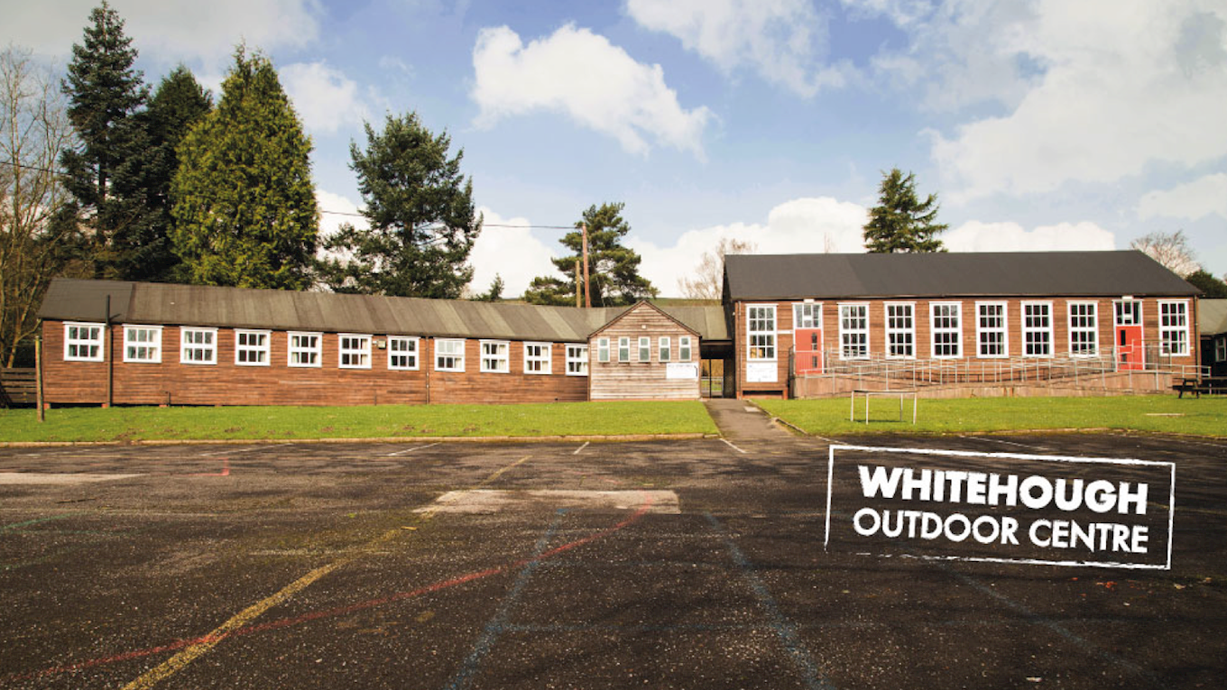
2025

Slide 2
Year 6 Residential
Monday 19th May – Thursday 22nd May 2025
£310 paid in full by Friday 2nd May

Slide 3
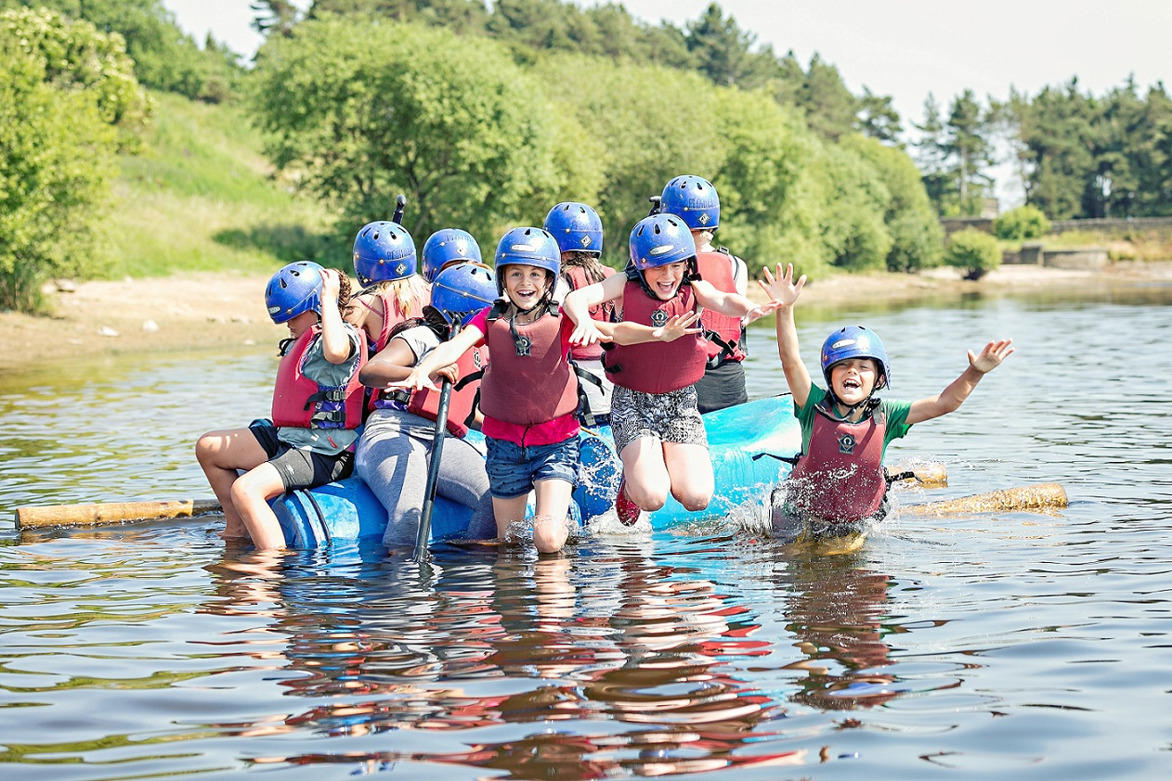
A day full of fun!
Every day at Whitehough is different, but some typical timings would look like this:
7am - Wake Up/Shower
7.30am-9.00am – Breakfast, and prepare for days activities
9.15am – meet your instructor at the rendezvous point
9.30am – 5.00pm – Activity
5.00pm – Free Time
5.30pm/7.00pm – Evening Meal/Free Time
7.00pm – 9.00pm – Evening Activity
9.00 – 10.00pm – Free Time/Supper
10.15pm – Lights Out

Slide 4
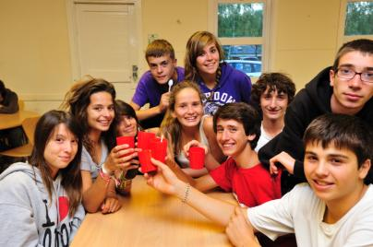
Food, Glorious Food!
3 substantial meals per day will be provided.
Breakfast will be ‘continental’ style, and will include, cereal, fruit and toast – help yourself buffet
Lunch – packed lunch for full day off site activity / Hot lunch on site
Menu choices – 3 most popular
Whitehough cater for all religious and dietary needs – just let us know in advance.

Slide 5
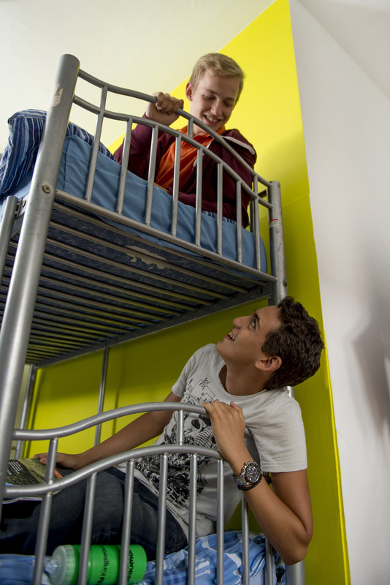
Sleeping – a home away from home!
• All residential dormitories are warm, comfortable and 100% secure – may need to be mixed dorms
• Teachers rooms are located close by to allow for plenty of close supervision
• All bedding is provided at the center - one of the very first tasks for all students is making up their own beds!
• Separate showers and toilet facilities are available for girls and boys

Slide 6
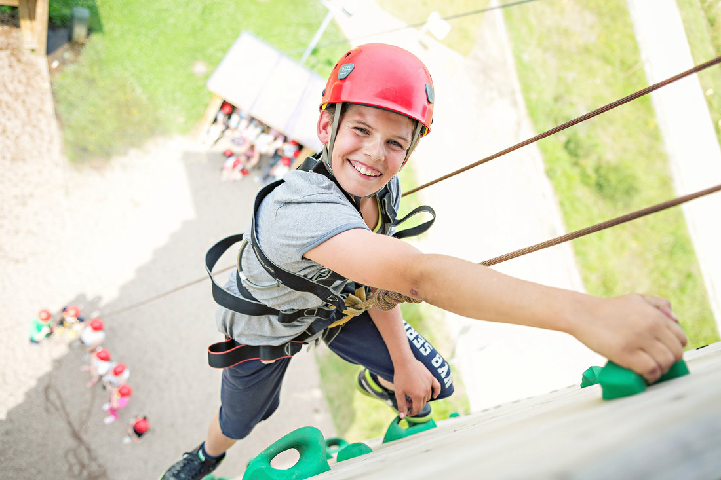
What Should My Child Wear:
Old Trainers/Walking Boots
Indoor Shoes/Trainers - clean
Other trousers e.g. tracksuit/leggings/walking pants/shorts
Thick Socks for Walking
T-Shirts (no vest tops)
Long sleeved tops
Hoodies/Jumpers
Hats/Gloves – trees!
Jeans – evenings only

Slide 7
What Should My Child Wear:
Underwear
Nightwear- pjs/dressing gown/oodie
Slippers/sliders/crocs
Towel
Toiletries – no hair driers/straighteners
Teddy / Book

Slide 8
Activities
Leap of Faith
Crate Stack
High Walkway
Orienteering
Archery
Jacob’s Ladder
High Ropes
Abseiling
Survival Skills

Slide 9
Briercliffe Staffing
Ratio of 1:10 – in addition to instructors
Male and Female staff

Slide 10
Other info
No phones / mobile devices
Sun cream – children to apply – ears!
Luggage – packing / carrying
Packed Lunch on day one
Named refillable water bottle
Small rucksack

Slide 11
Medical info
Consent form
Medicines – form
All given to Mr Hartley – Monday am
Calpol/Antihistamine

Slide 12
Spending Money
Evening Tuck Shop – crisps, sweets, chocolate
£10 – named wallet/envelope
In change if possible!

Slide 13
Any questions???

