Slide 1
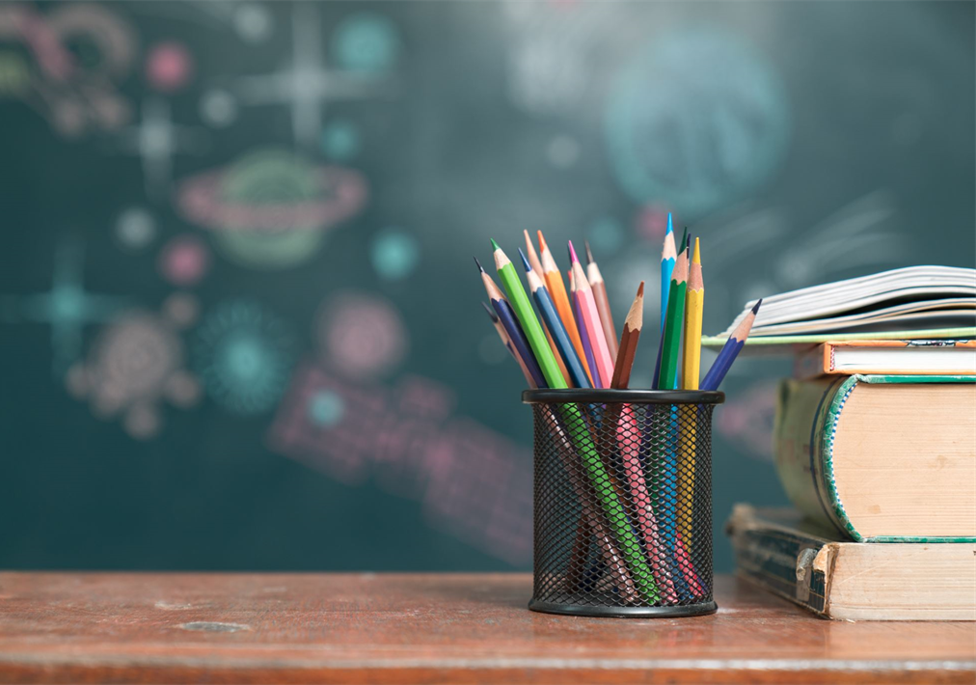
Meet the Teacher
September
2025
Welcome to Year 6

Slide 2
Teachers
Teacher: Miss Beesley
PPA cover one afternoon a week
PE 2 sessions each week – PE kit in school at all times please!

Slide 3
Times
Not on the yard alone - injuries
Start of the school day – 8.55am (morning challenge)
Door – LKS2 door – doors open 8:45am
End of the school day – 3.30pm
Door / arrangements
If your child is being collected by anyone different eg a friend’s mum, please inform school.
Year 5 and 6 - Are they walking Home?
Written permission please
Morning –doors open 8.45am
(morning challenge)
Lunch – 12:20pm

Slide 4
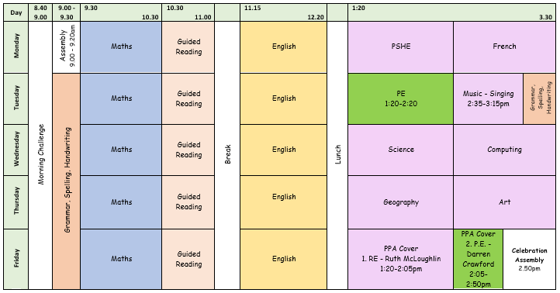
Example Timetable

Slide 5
Playtime
Fruit available everyday
Fruit, vegetables, cheese or yoghurt from home
Times
Morning –
11 - 11:15

Slide 6

Homework
Out: Friday Due in: Wednesday ​
Homework handed in by Wednesday please
Alternate Math and English homework
Children to read minimum 3 times per week and have their reading record signed.​
Homework info shared via Dojo
Homework Club – Thursday

Slide 7


Reading
Reading at least 3 times a week!
Books are changed..... Children have to put their own reading packets in the correct box.....They need to bring their books everyday please.

Slide 8
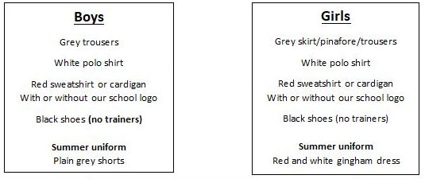
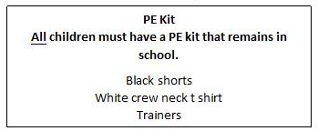
School uniform
If earrings are worn, they must be small plain studs and for health and safety reasons must not be worn for PE
Please make sure all uniform is clearly named (and renamed in the year)
No watches or jewellery
No rucksacks or pencil cases

Slide 9

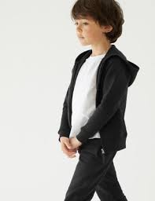
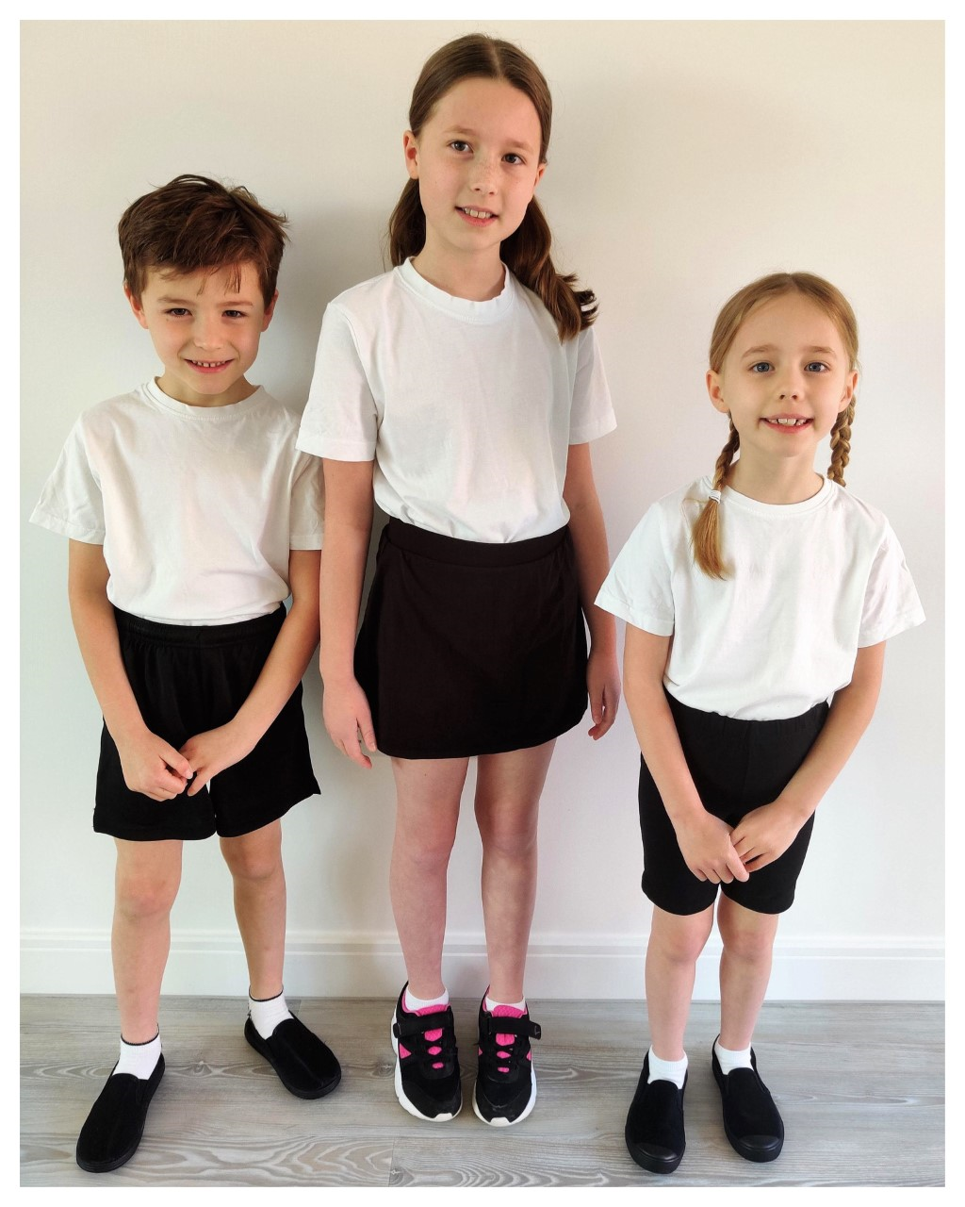

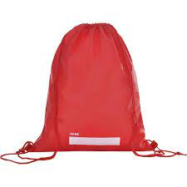
P.E.
P.E. Will be twice a week. The days will be shared on the class newsletter in September. Please ensure your child has a full PE kit in school at all times. black/navy shorts or joggers and a white T-shirt, black pumps or trainers.
Shorts need to be an appropriate length e.g. Nike Pro 3inch and 5inch length are too short for school PE lessons.
Please label everything!

Slide 10
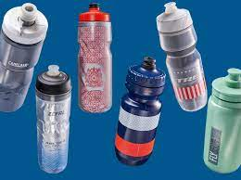
Water Bottles
Please bring in a filled water bottle with your child’s name on. The children will be able to drink water throughout the day. Water only please!

Slide 11


Updates
Reminders
Links to learning on class page- Website
Unfortunately, we can’t use it as a messaging service. Please speak to or email the school office if you need to contact us directly.
Please come and speak to me

Slide 12
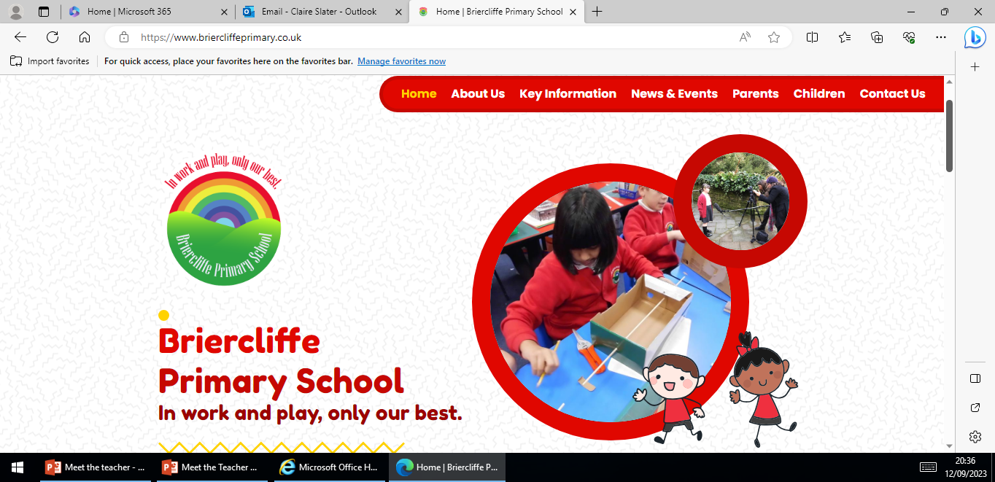
Website
Website Home | Briercliffe Primary School
Calendar
Class newsletter
Photos

Slide 13
Independence
Organisation
Looking after belongings
Shoelaces
Packing bags at the end of the day
Within learning (resilience)
Reading books

Slide 14
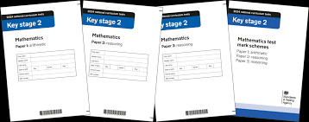
National Assessments
Dates:
Monday, May 11th to
Thursday, May 14th, 2026

Slide 15
Medication
If your child needs any prescribed medication please complete a medicine form.
We will administer non-prescribed medicine e.g. antihistamine but this must be a brand new sealed bottle accompanied by a medicine form.
All medicine to be taken to the school office.

Slide 16

Parents Evening
October or November

Slide 17
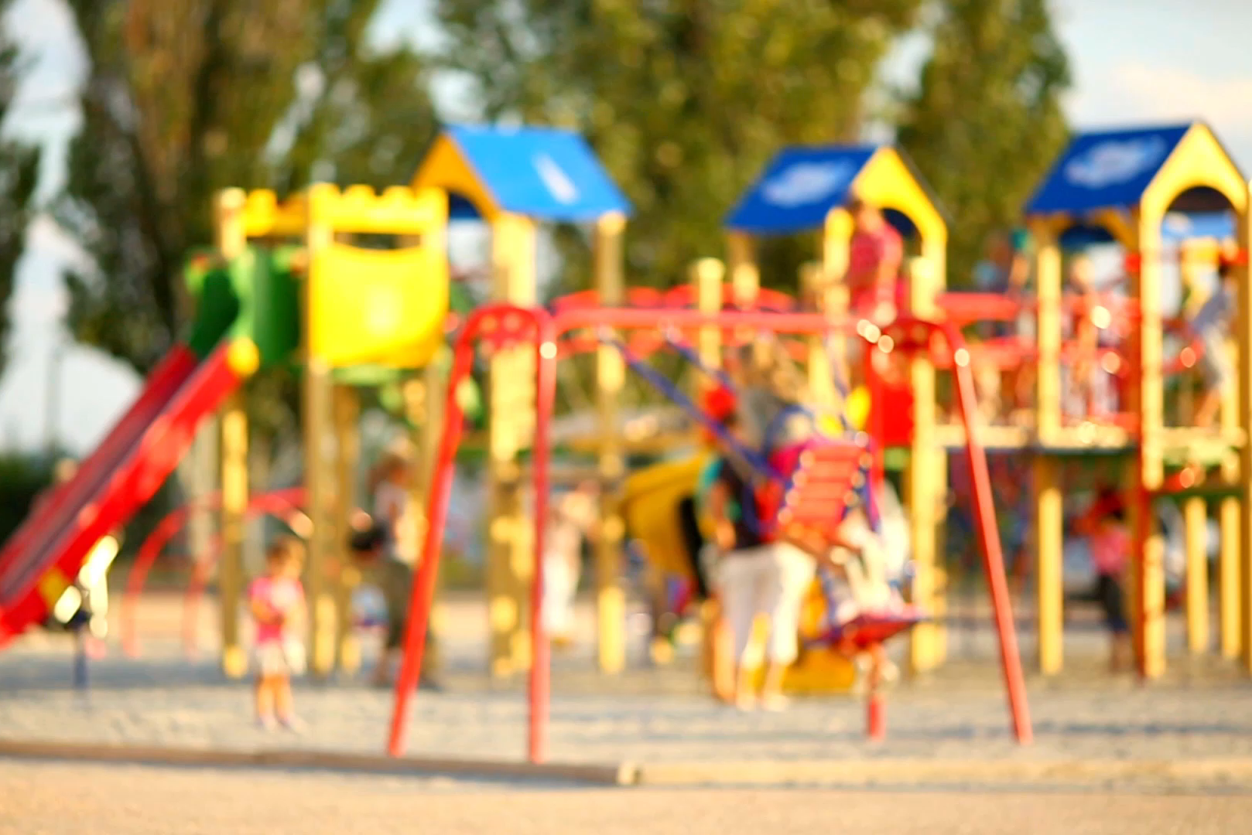
Please Remember…
Send your child in with:
PE kit
Water bottle
Coat
Book bag
Labelling!
After school and before school please can children not play on climbing frames/trim trails.

Slide 18
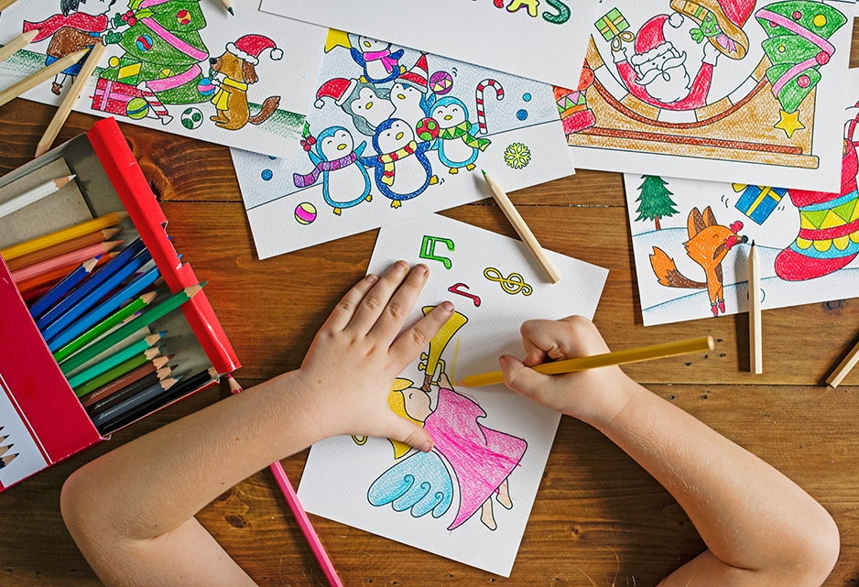
Any questions?

Slide 19
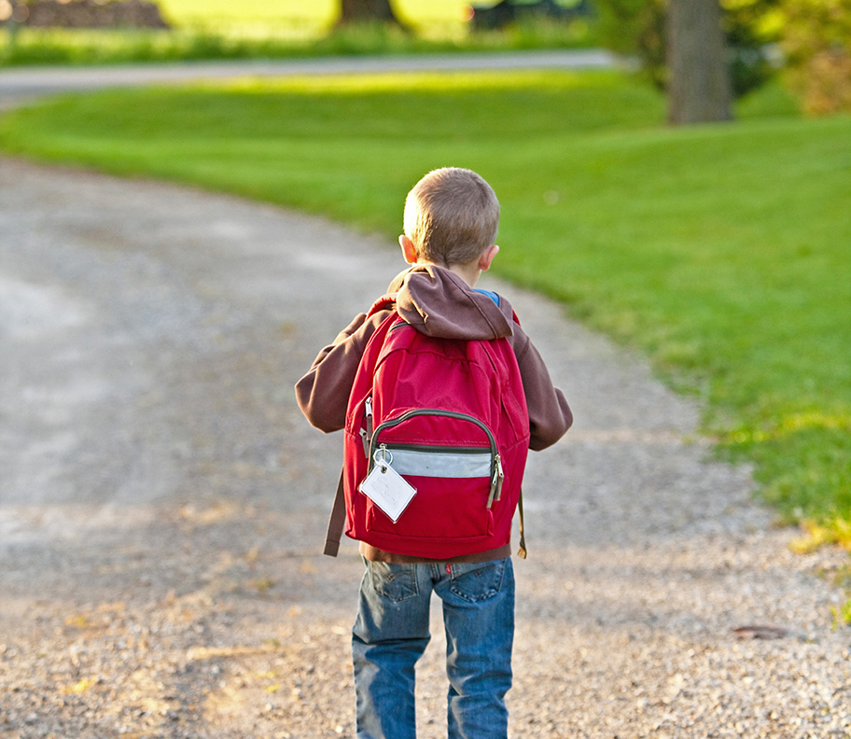
Thank You!

