Slide 1

Birthdays!
Please colour in a birthday card!
Every time it’s someone’s birthday
they will receive a card from the
class.

Slide 2
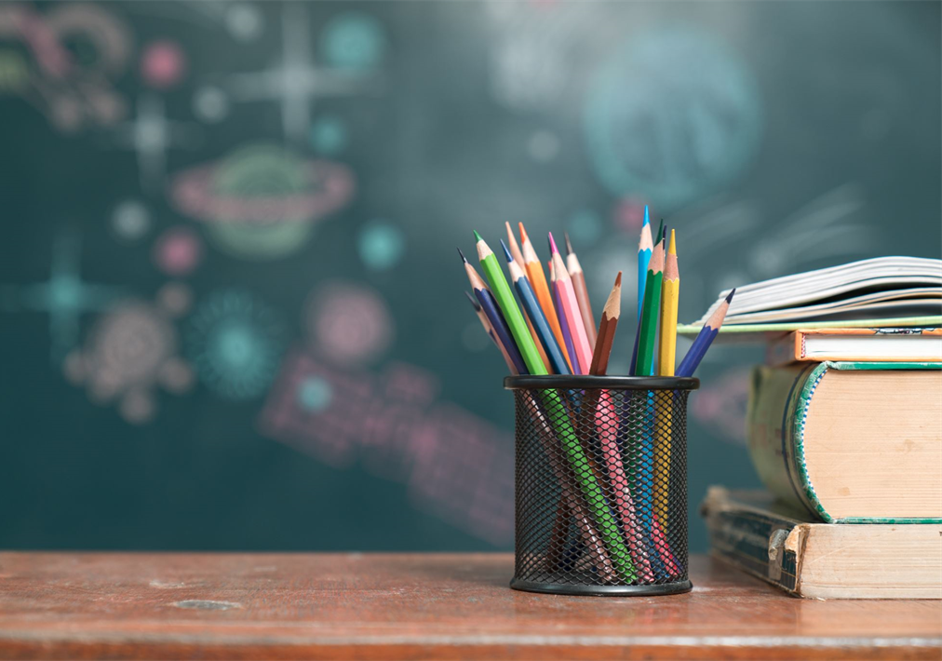
Meet the Teacher
September
2025
Welcome to Year 3C

Slide 3
Teachers
Miss Coar
PPA cover one afternoon a week
PE 2 sessions each week
PE kit must be in school at all times please and named! No earrings to be worn for PE.

Slide 4
Times
Start of the school day – 8.55am
Door – 8.45am
Morning Challenge 8.55am
End of the school day – 3.30pm
Door / arrangements – children will be
brought out on to the playground and will be
released from the line
Morning –doors open 8.45am
Lunch – 12.20pm

Slide 5
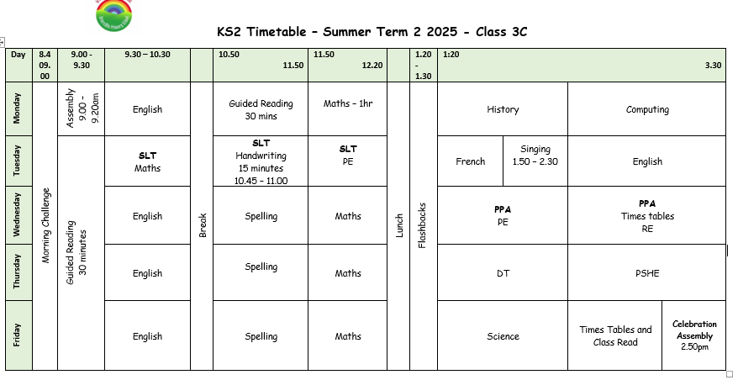
Example Timetable

Slide 6
Playtime
Fruit available everyday
Fruit, vegetables, cheese or yoghurt from home
Times
Morning – 10.30am – 10.45am

Slide 7

Homework
Out: Friday
Due in: Wednesday ​
Homework handed in by Wednesday please!
Alternate Math and English homework
Children to read minimum 3 times per week and have their reading record signed.​
Times Table Rockstars – prepare for Y4
Homework / Reading Club: Thursday lunch times

Slide 8

Reading
Reading at least 3 times a week!
Books are changed as and when needed.
Children have to put their own reading packets in the correct box.
They need to bring their books everyday please in order for me to read with your child.

Slide 9
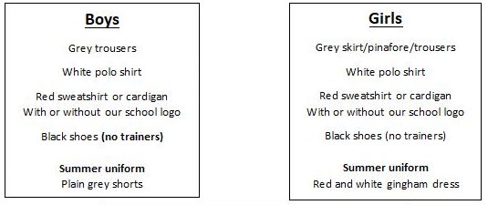
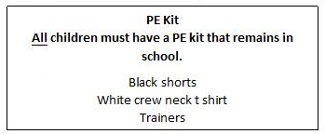
School uniform
If earrings are worn, they must be small plain studs and for health and safety reasons must not be worn for PE
Please make sure all uniform is clearly named
No watches or jewellery
No rucksacks or pencil cases

Slide 10

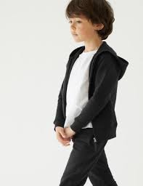
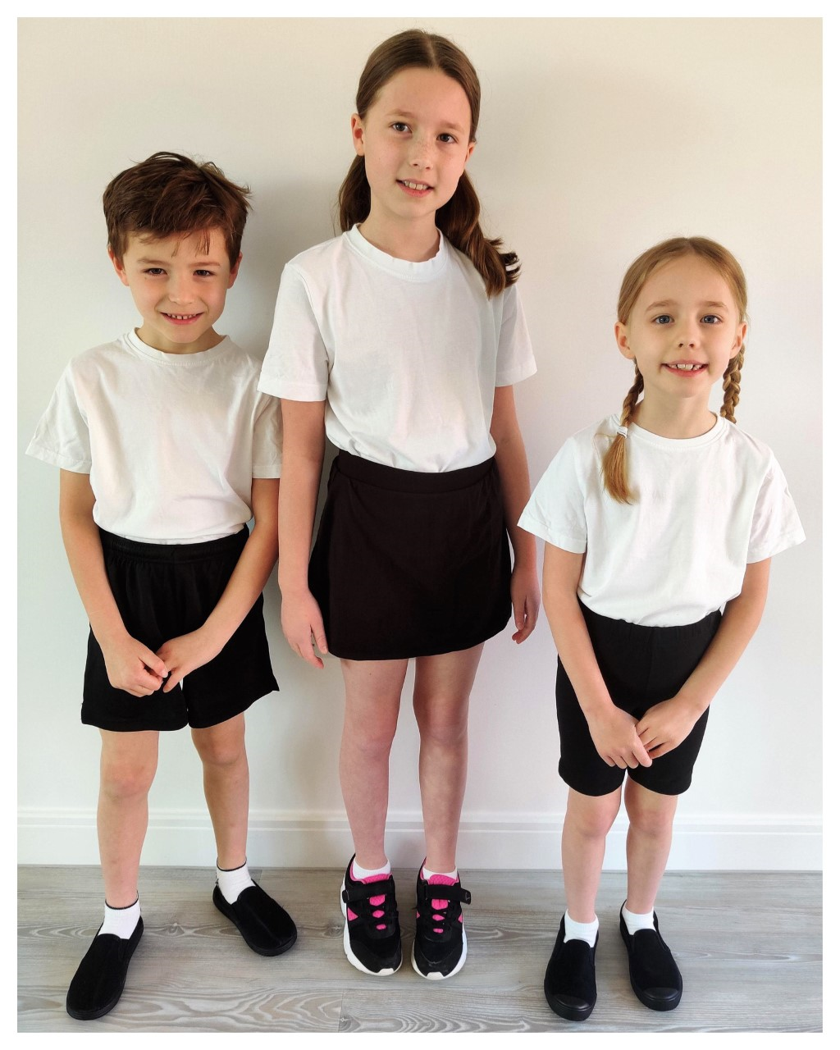

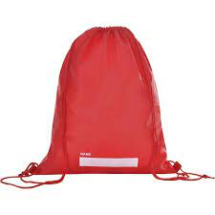
P.E.
P.E. Will be twice a week. The days will be shared on the class newsletter in September. Please ensure your child has a full PE kit in school at all times. black/navy shorts or joggers and a white T-shirt, black pumps or trainers.
Please label everything!

Slide 11

Water Bottles
Please bring in a filled water bottle with your child’s name on. The children will be able to drink water throughout the day. Water only please!

Slide 12


Updates
Reminders
Links to learning on class page- Website
Unfortunately, we can’t use it as a messaging service. Please speak to or email the school office if you need to contact us directly.

Slide 13
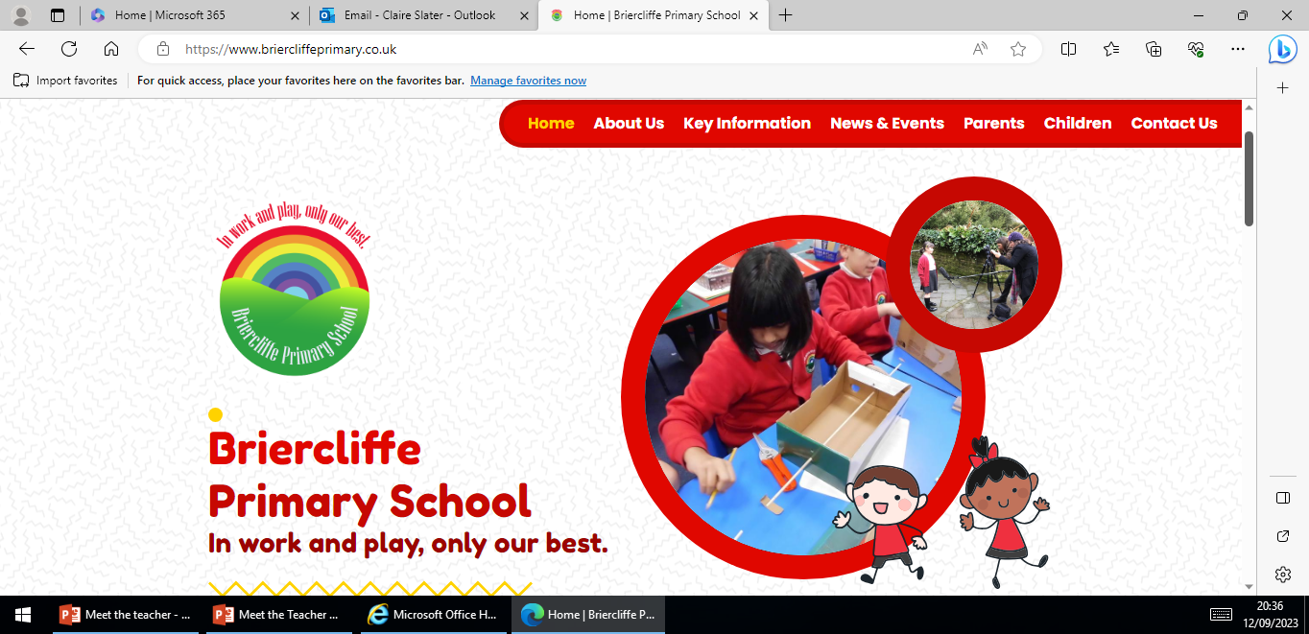
Website
Website Home | Briercliffe Primary School
Calendar
Class newsletter
Photos

Slide 14
Independence
Organisation
Looking after belongings
Shoelaces
Packing bags at the end of the day
Within learning
Reading books

Slide 15
National Assessments
Dates -

Slide 16
Medication
If your child needs any prescribed medication please complete a medicine form.
We will administer non prescribed medicine eg antihistamine but this must be a brand new sealed bottle accompanied by a medicine form.
All medicine to be taken to the school office.

Slide 17

Parents Evening
October or November

Slide 18
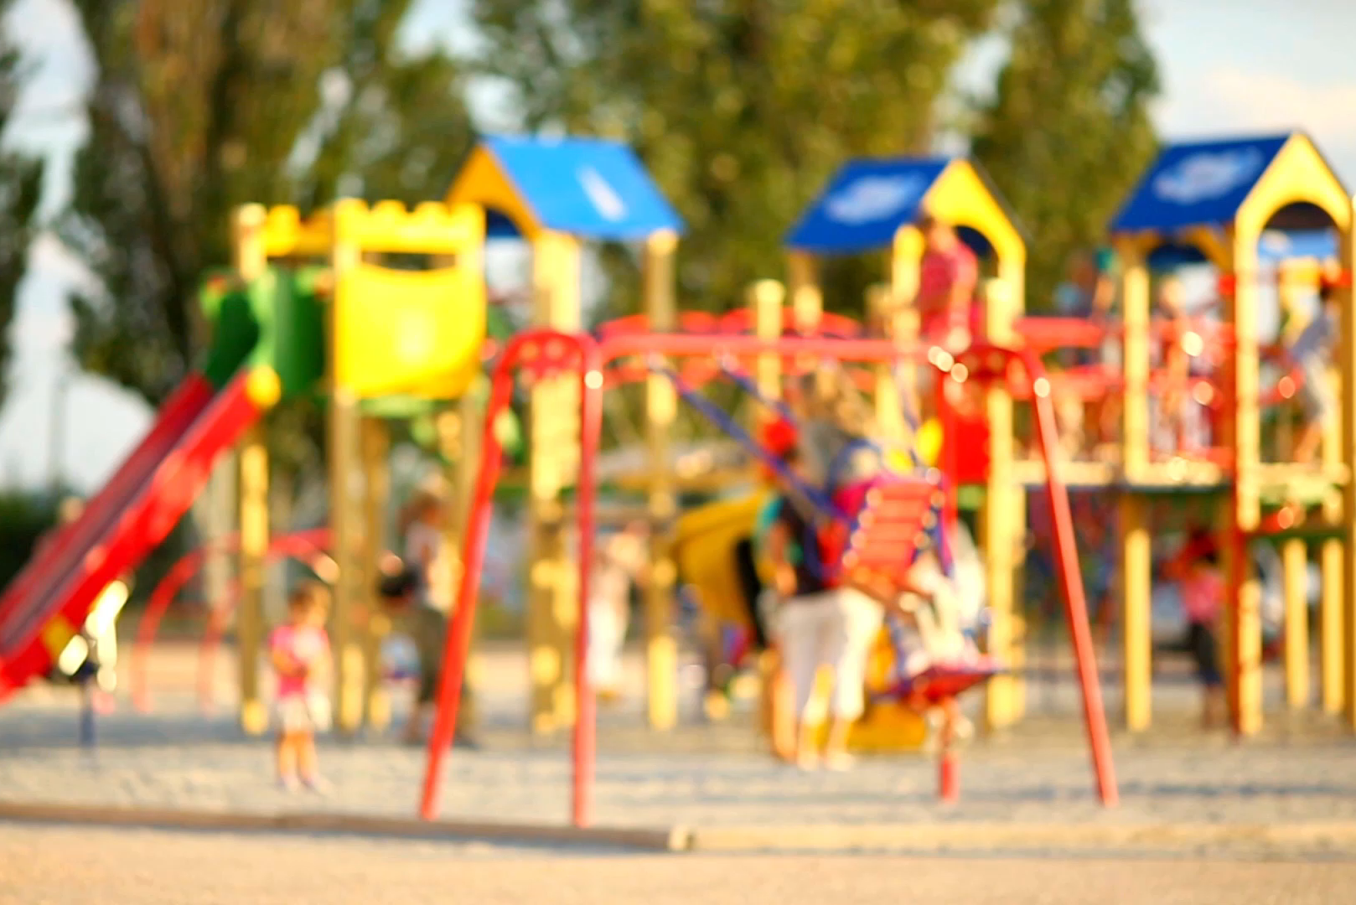
Please Remember…
Send your child in with:
PE kit
Water bottle
Coat
Book bag
Labelling!
After school and before school please can children not play on climbing frames/trim trails.

Slide 19
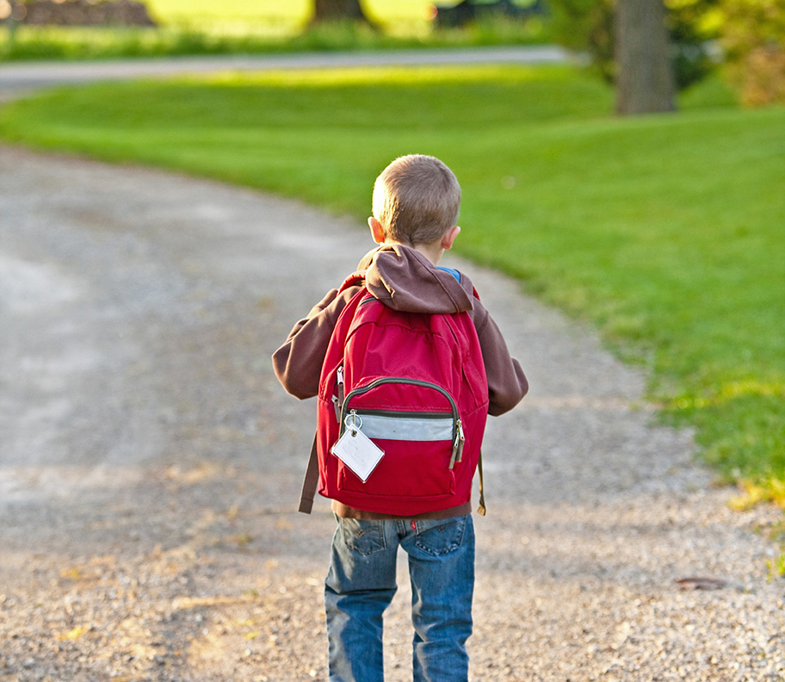
Thank You!

