Slide 1
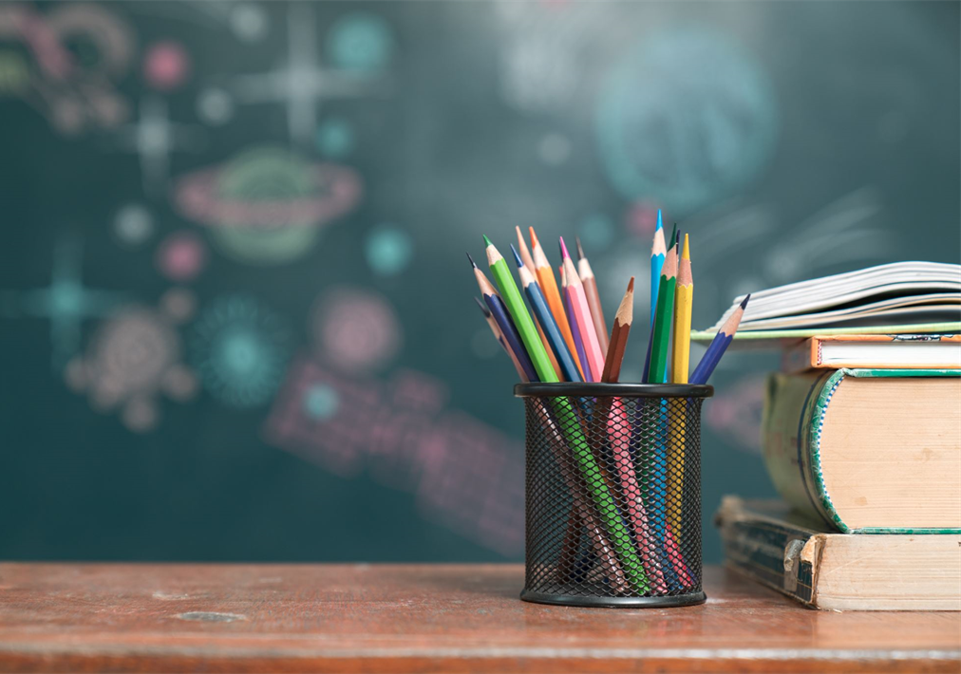
Meet the Teacher
September
2025
Welcome to Year 1

Slide 2
Times
Start of the school day – 8.55am
Door -
Morning Challenge
End of the school day – 3.30pm
Door / arrangements
If your child is being collected by anyone different e.g. a friend’s mum, please inform school.
Morning –doors open 8.45am
Lunch – 12.00-1.00pm

Slide 3
Playtime
Fruit available everyday
Fruit, vegetables, cheese or yoghurt from home
Times
Morning –
10.20-10.35
Afternoon –
2.10-2.20

Slide 4
Year 1 main changes
Lunchtimes are 12-1pm.
No Tapestry.
Own tray
Table places
Home reading packets
No continuous provision
No forest school – outdoor learning

Slide 5
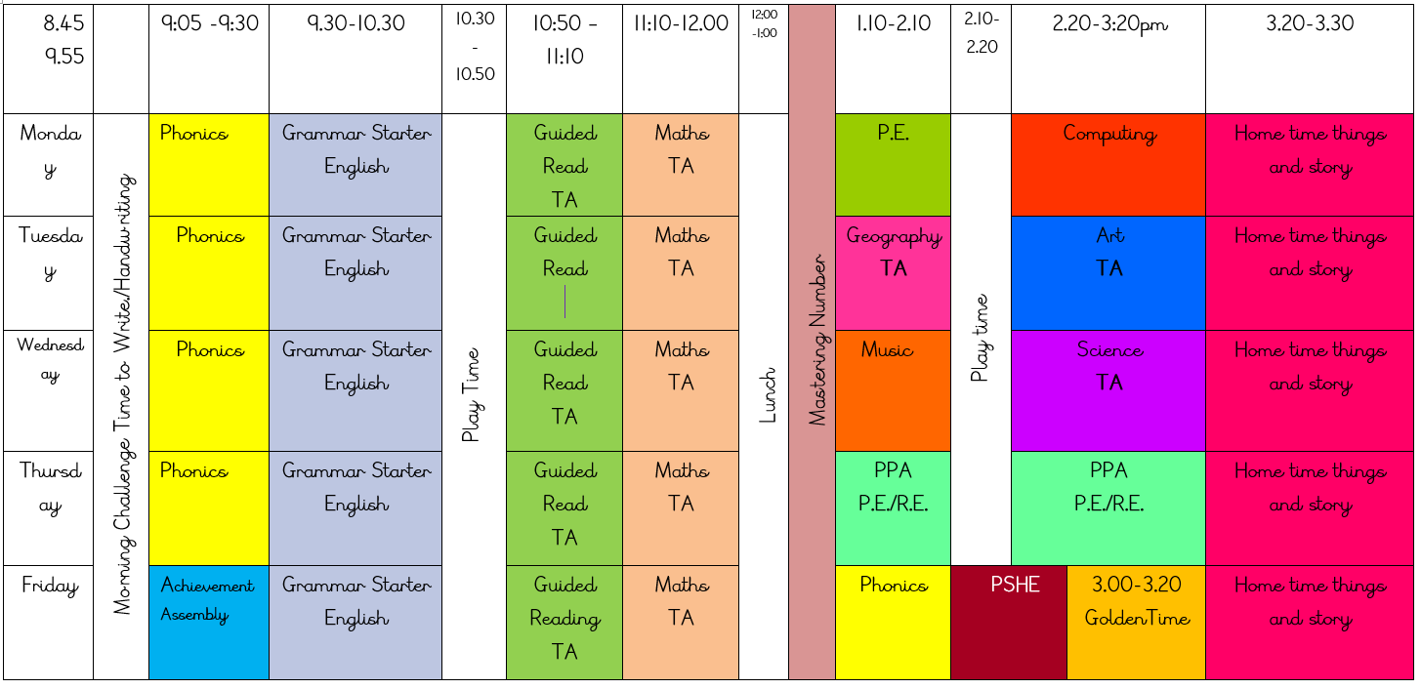
Our Timetable

Slide 6
Topics
Autumn 1 | Autumn 2 | Spring 1 | Spring 2 | Summer 1 | Summer 2
Geography- Local area Humans /body parts Seasons and weather Kandinsky circles | History - Toys Humans - senses DT - Food | UK Capitals Materials Painting - Picasso | Great Fire of London Materials Sculpture Sliders and Levers | Geography – Burnley/ Briercliffe Animals Collage | Schools in the Past Animals Structures

Slide 7
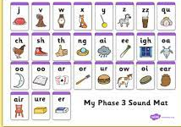
Homework
Out: Friday Due in: Wednesday ​
Alternate Maths/English homework weekly.​
Children to read minimum 3 times per week.​
Graphemes taught in phonics are shared on Dojo for you to practice at home. No spelling test.
5 Dojo points will be given weekly for completed homework done at home.​

Slide 8

Reading
If children read 3 times a week they will get a raffle ticket.
Books can be changed on Tuesdays and Fridays. Children have to put their own reading packets in their guided reading boxes and they will be changed on those days. Please bring them every day to school regardless of if they have read or not as we have adults in school to read with children.
Children will be getting reading books that closely matching their phonic levels. Please ignore the book bands.

Slide 9
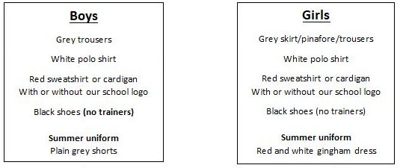
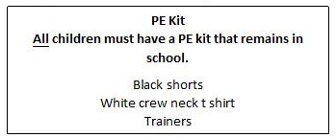
School uniform
Jewellery is not allowed to be worn in school.
No watches allowed.
If earrings are worn, they must be small plain studs and for health and safety reasons must not be worn for PE.
Please make sure all uniform is clearly named.

Slide 10

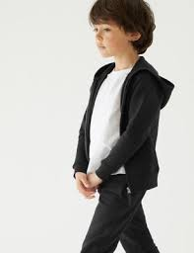
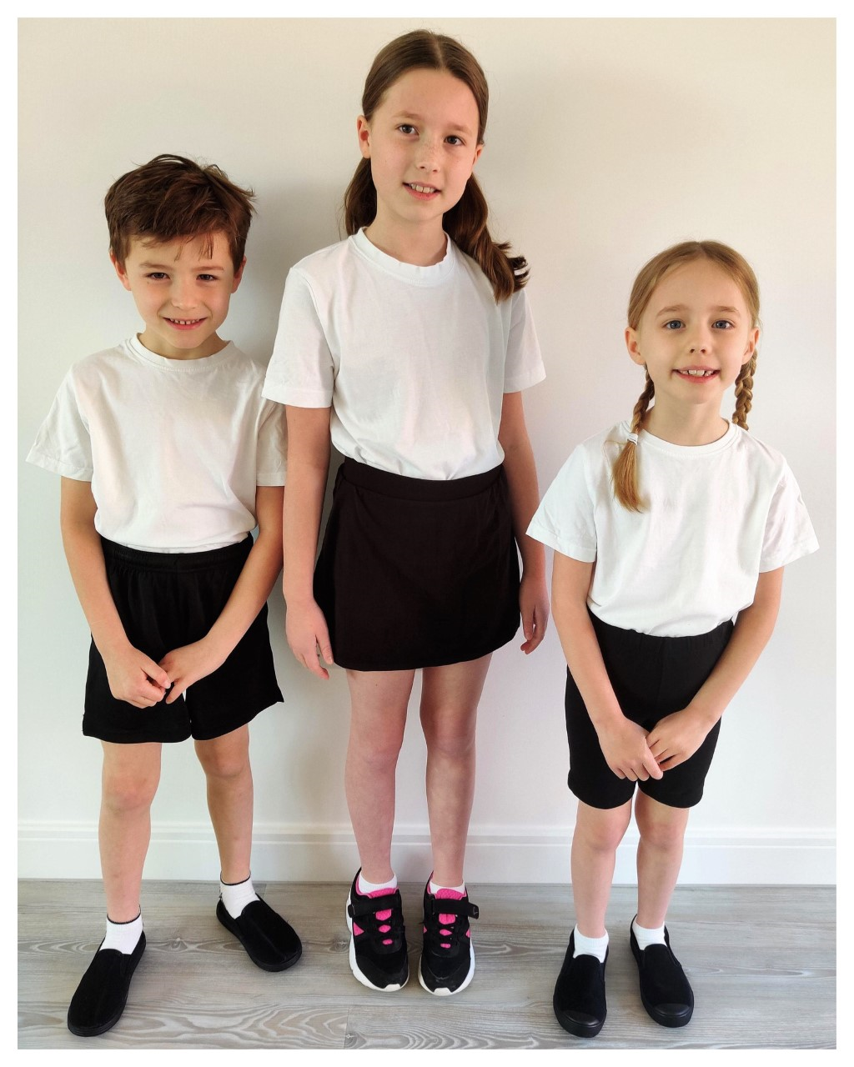

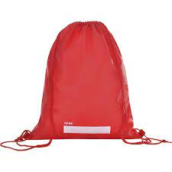
P.E.
P.E. days will be announced soon. Please ensure your child has a full PE kit in school at all times. Black/Navy shorts and a white T-shirt. Black Pumps or trainers.
Outdoor PE kits also needed at all times in school.

Slide 11
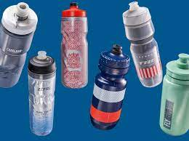
Water Bottles
Please bring in a filled water bottle with your child’s name on. The children will be able to drink water throughout the day. Please do not bring juice or cordial or flavoured water. Children can have water with fresh fruit in it.

Slide 12


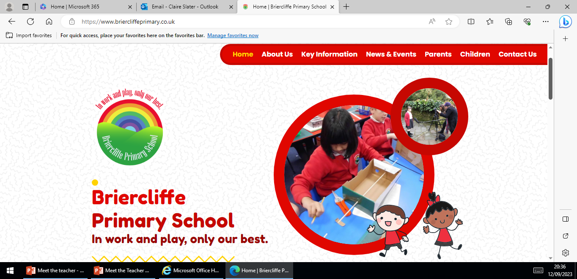
Weekly phonics
Updates
Reminders
Links to learning on class page- Website
Can’t be used as a 2 way communication
Website Home | Briercliffe Primary School
Calendar
Knowledge organisers
Class newsletter
Photos

Slide 13
Independence
It is really important that your child develops more independence this year.
Organisation
Looking after belongings
Shoelaces
Packing bags at the end of the day
Within learning
Reading packets out of book bags.

Slide 14


To be announced
Phonics stay and play sessions

Slide 15
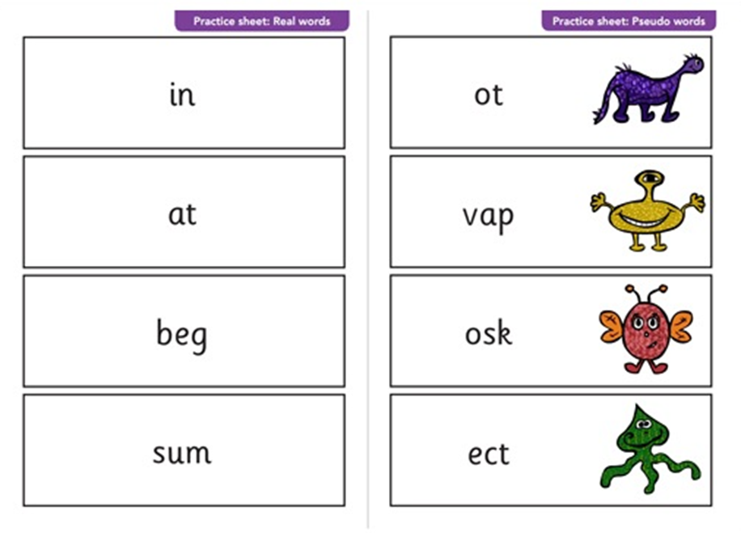

Phonics Screening

Slide 16
Medication
If your child needs any prescribed medication please complete a medicine form.
We will administer non prescribed medicine eg antihistamine but this must be a brand new sealed bottle accompanied by a medicine form.
All medicine to be taken to the school office.

Slide 17
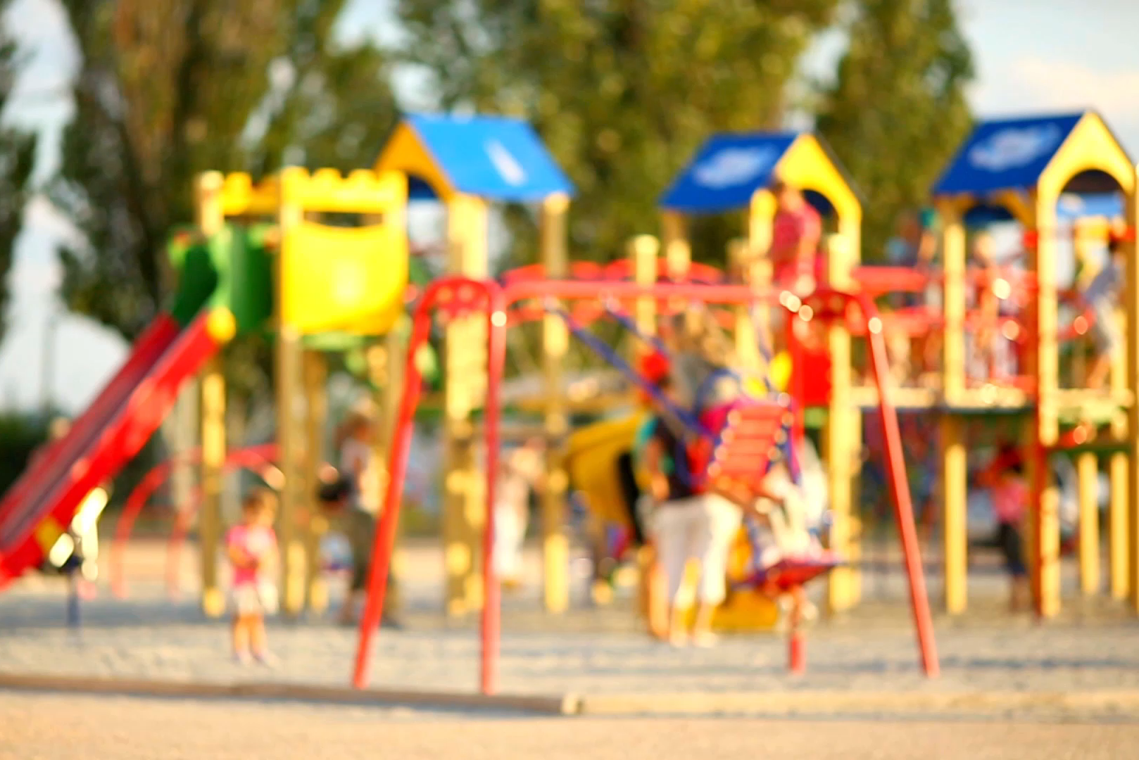
Please Remember…
Send your child in with:
PE kit
Water bottle
Coat (in all weathers)
Hat and sunscreen (in the summer)
Book bag
After school and before school please can children not play on climbing frames.

Slide 18
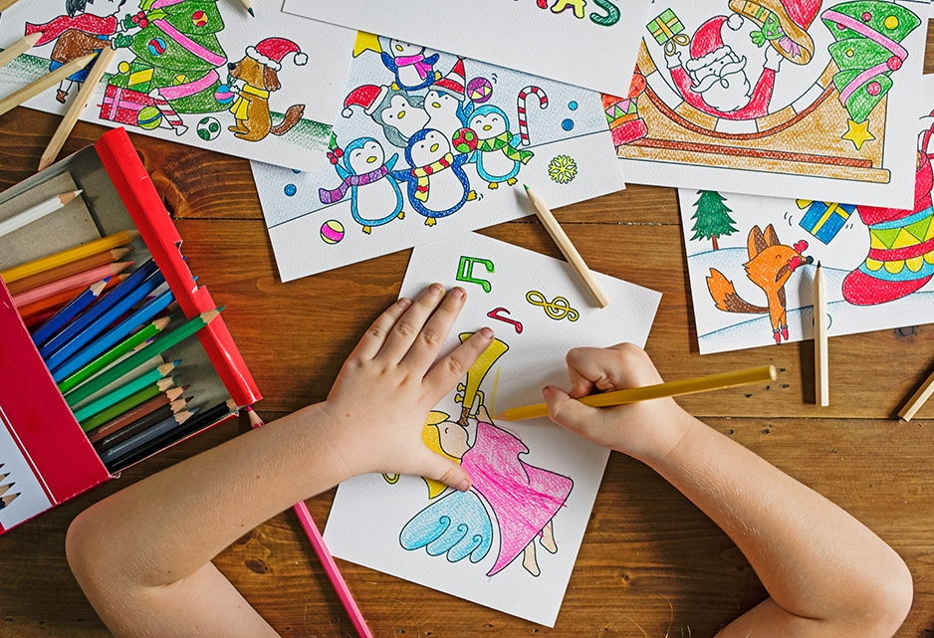
Any questions?

Slide 19
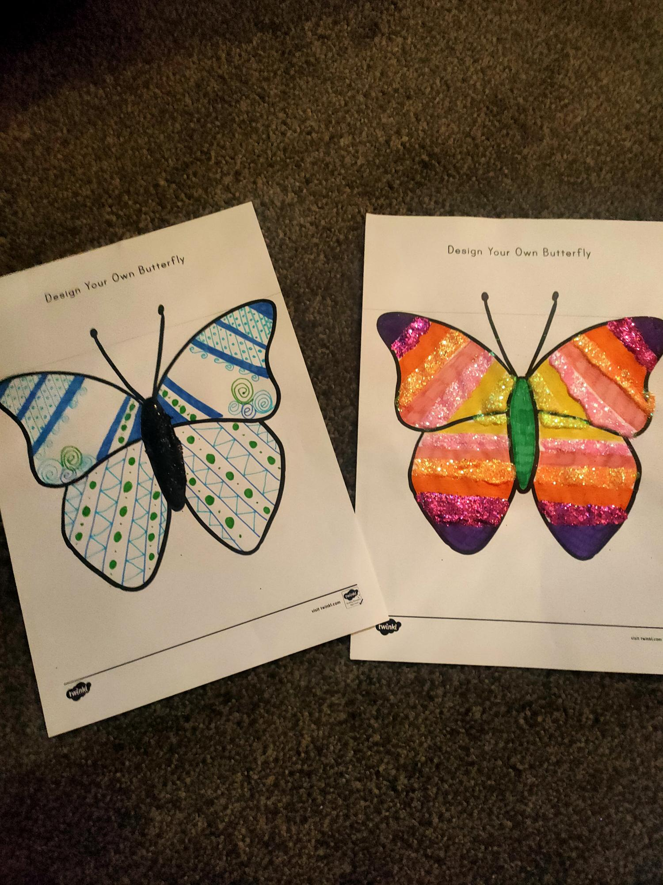
Ready to Spread our Wings in Year One

Slide 20
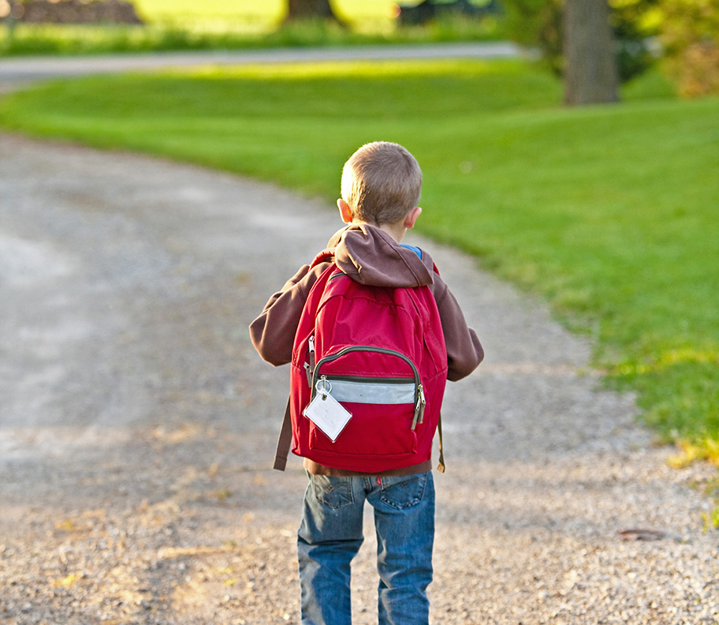
Thank You!

