Slide 1
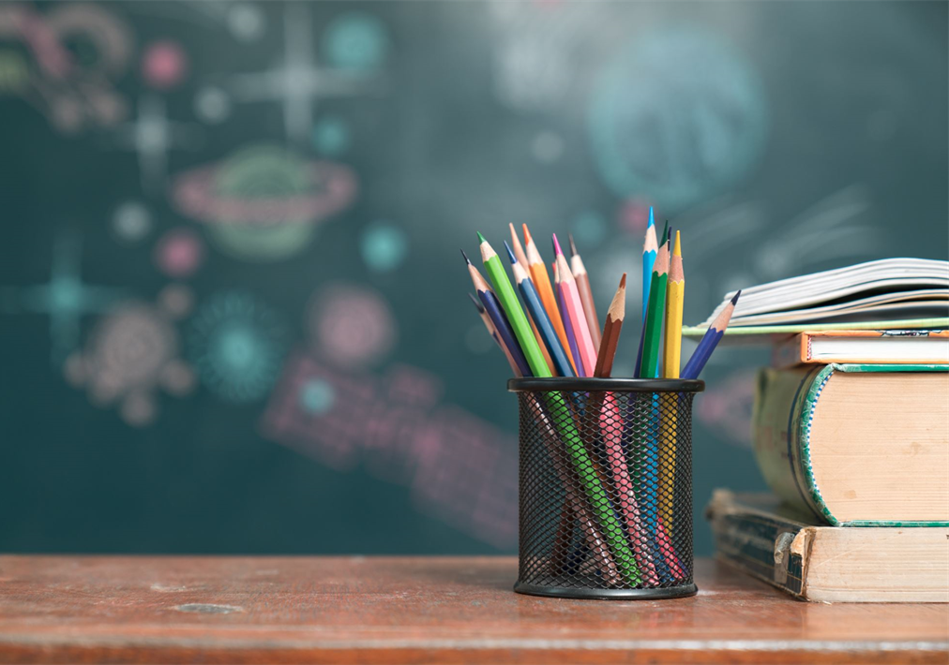
Meet the Teacher
September
2025-26
Welcome to Year 4

Slide 2
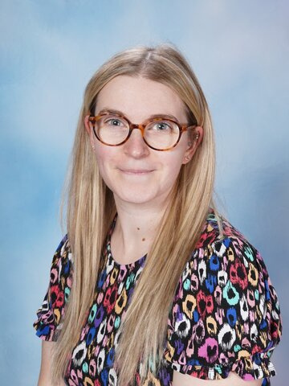
Teachers
Teacher: Miss Gawthorpe
PPA cover one afternoon a week
PE 2 sessions each week – PE kit in school at all times please!

Slide 3
Times
Start of the school day – 8.45am
Door - Around new hall on ks2 yard- Year 3 and year 6 entrance.
Morning Challenge- start as soon as they come into class until 9am
End of the school day – 3.30pm
Children will be brought onto the KS2 yard, lined up and dismissed one at a time.
If your child is being collected by anyone different e.g. a friend’s mum, please inform the school office.
Morning –doors open 8.45am
Lunch – 12.20-1.20pm

Slide 4
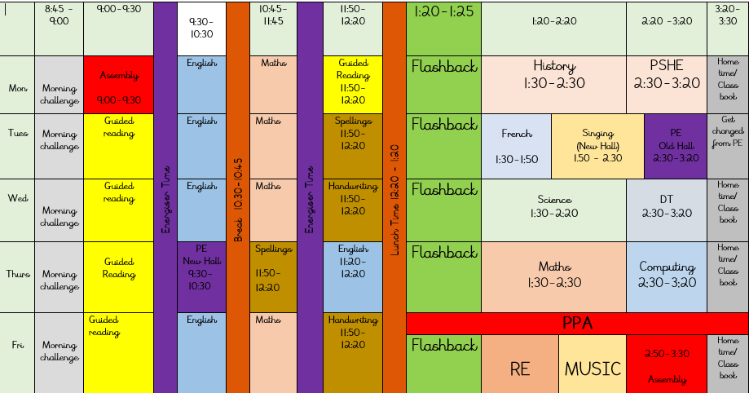
Example Timetable

Slide 5
Playtime
Fruit will be available everyday
Fruit, vegetables, cheese or yoghurt are the only snack for breaktime that may be brought from home.
Times
10.30 – 10.45

Slide 6

Homework
Out: Friday Due in: Wednesday ​
Homework handed in by Wednesday!
Alternate Math and English homework
Children to read minimum 3 times per week and have their reading record signed by an adult.
TTR info shared via Dojo
Homework Club – Thursday

Slide 7

Reading
Children have to put their own reading bags in the correct box for their Guided Reading group.
They need to bring their books everyday please.
Reading at least 3 times a week!
Wednesday to Wednesday = Reading Week

Slide 8
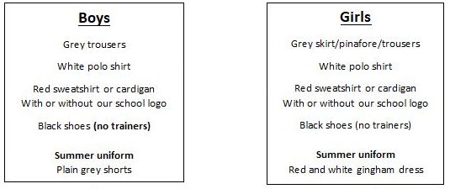
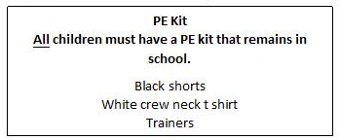
School uniform
If earrings are worn, they must be small plain studs and for health and safety reasons must not be worn for PE.
Please make sure all uniform is clearly named.
No watches or jewellery.
No rucksacks or pencil cases.

Slide 9

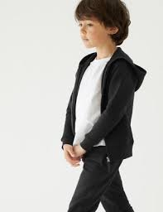
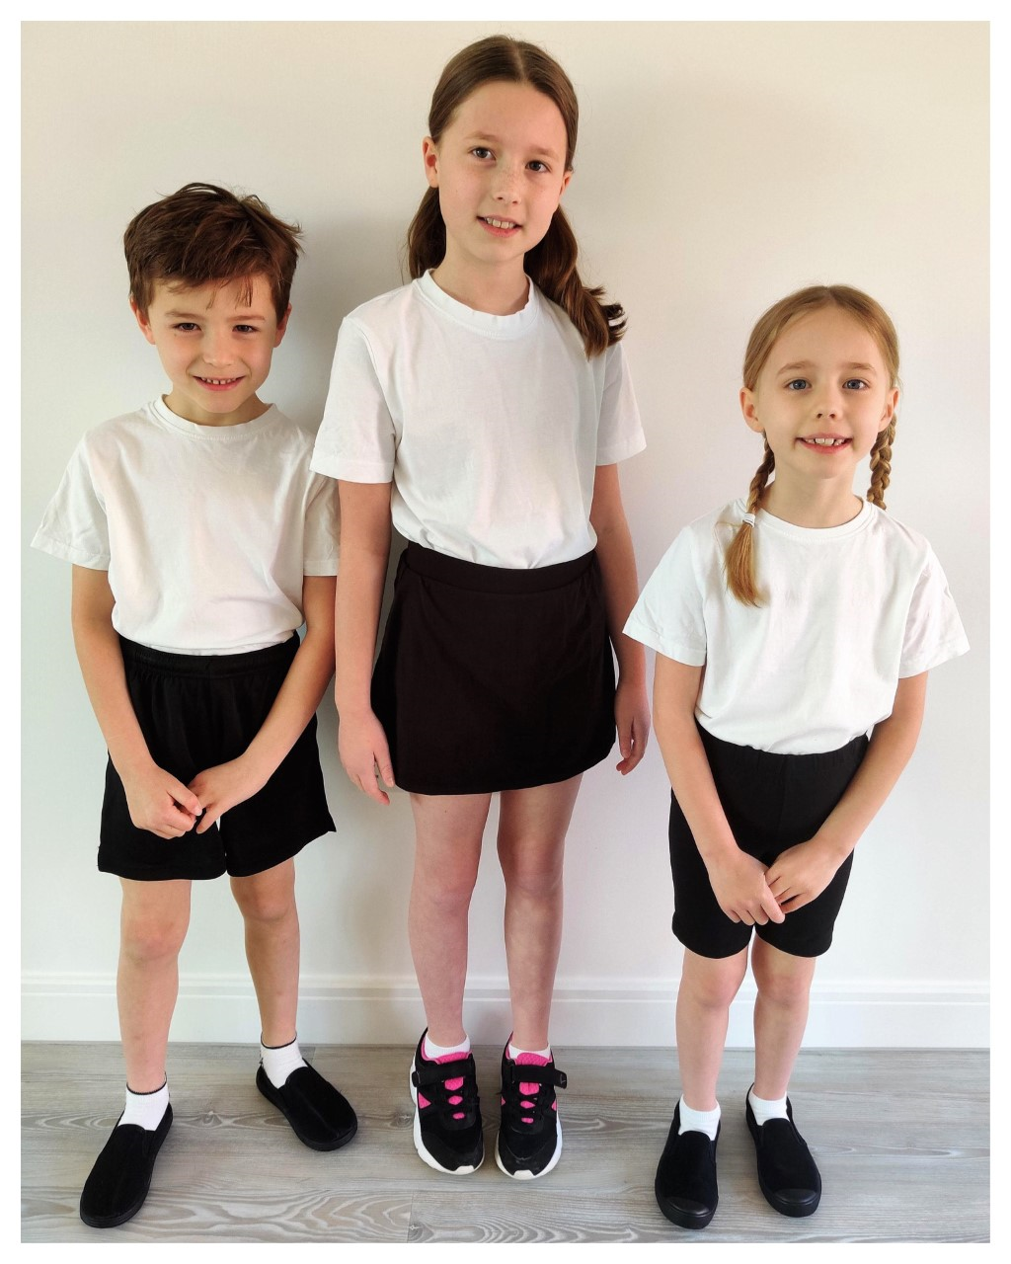

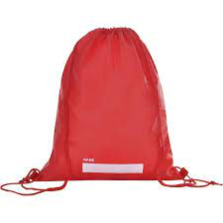
P.E.
Will be twice a week.
The days will be shared on the class newsletter in September.
Please ensure your child has a full PE kit in school at all times.
Black/navy shorts or joggers and a white T-shirt, black pumps or trainers.
Please label everything!

Slide 10

Water Bottles
Please bring in a filled water bottle with your child’s name on.
Water has a station by the sink where your bottle can stay during the day.
Water only please!

Slide 11


Updates
Reminders
Weekly Websites – Class pages link
Class Dojos - We can’t use it as a messaging service. Please speak to me or email the school office if you need to contact us directly.
Every 100 Dojos you get, you can go into Miss Gawthorpe’s rewards box

Slide 12
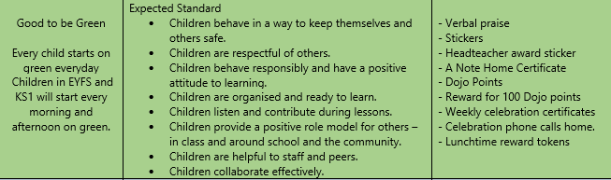
Good to be Green

Slide 13
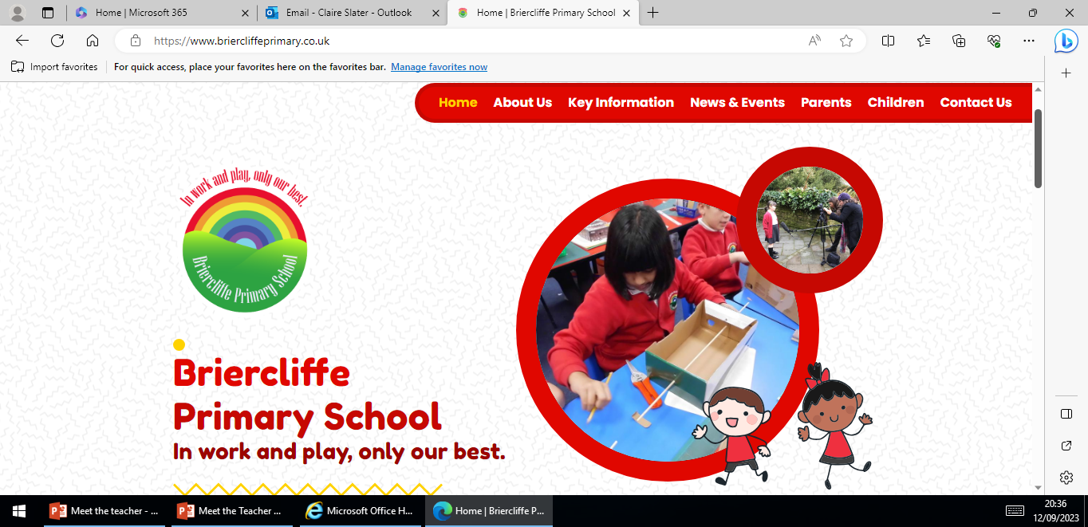
Website
Website
Home | Briercliffe Primary School
Calendar
Class newsletter
Photos of the week’s learning

Slide 14
Independence
Organisation
Looking after belongings
Shoelaces
Packing bags at the end of the day
Within learning
Reading books

Slide 15

National Assessments
Multiplication tables check.
Statutory
Fluent recall of times tables.
Dates – June 2026

Slide 16
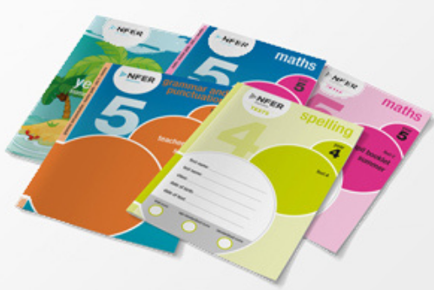
National Assessments
NFER
Statutory -
Autumn
Spring
Summer

Slide 17
Medication
If your child needs any prescribed medication please complete a medicine form.
We will administer non prescribed medicine eg antihistamine but this must be a brand new sealed bottle accompanied by a medicine form.
All medicine to be taken to the school office.

Slide 18

Parents Evening
October or November
You will be asked to book your appointment on Scopay nearer the time.

Slide 19
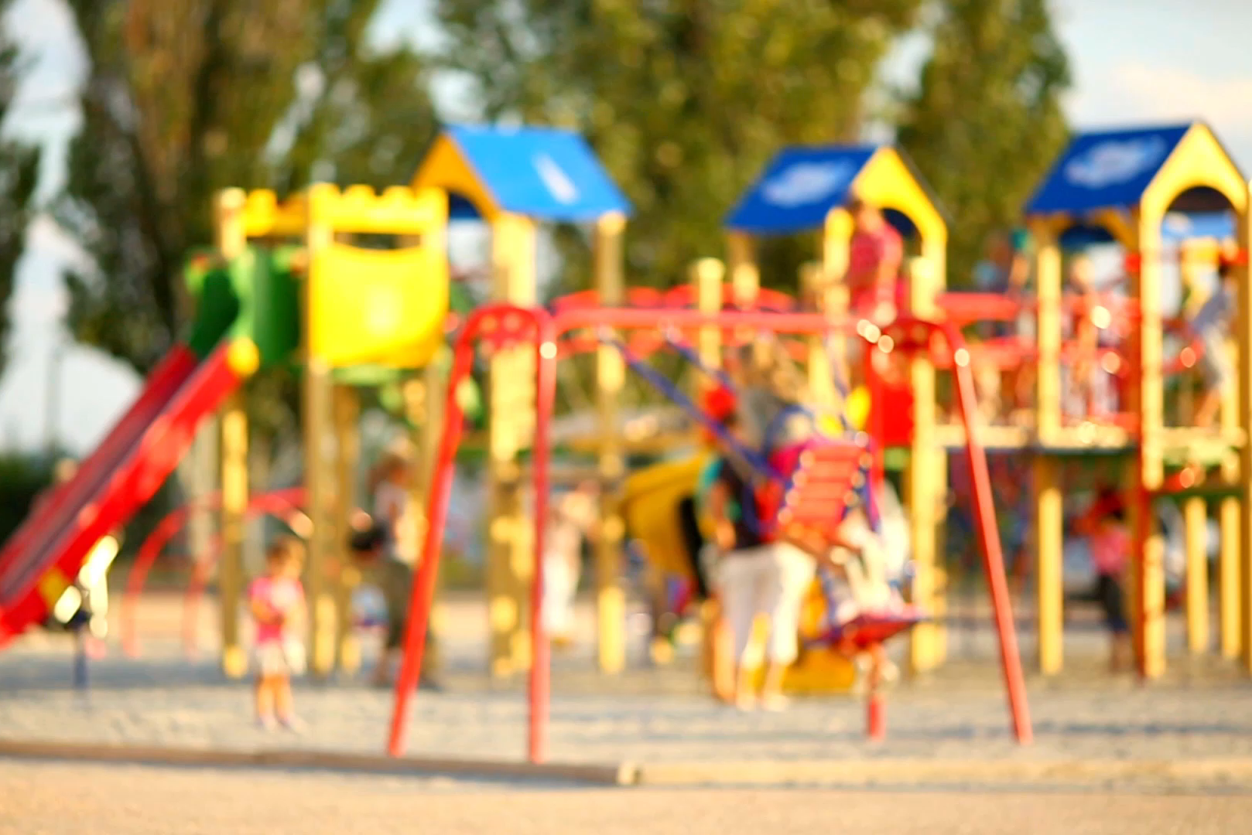
Please Remember…
Send your child in with:
PE kit
Water bottle
Coat
Book bag
Labelling!
After school and before school please can children not play on climbing frames/trim trails.

Slide 20
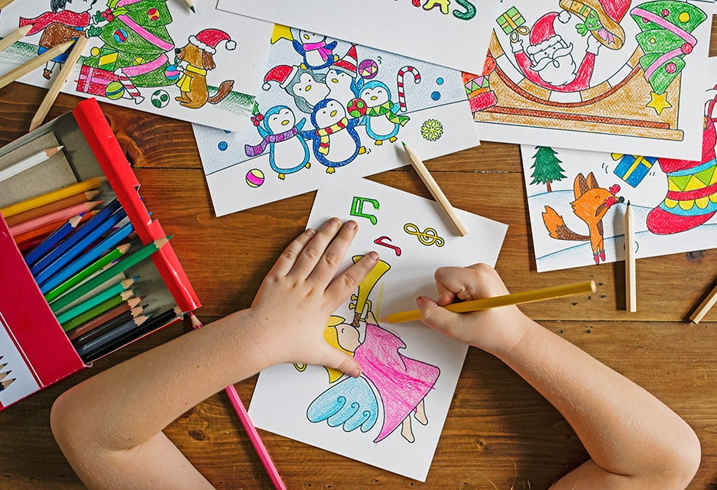
Any questions?

Slide 21
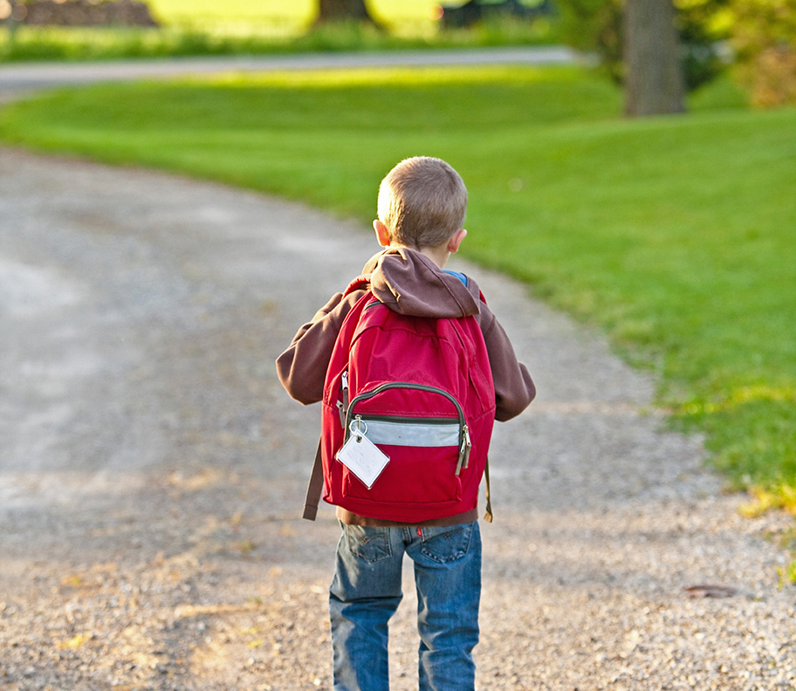
Thank You!

