Slide 1
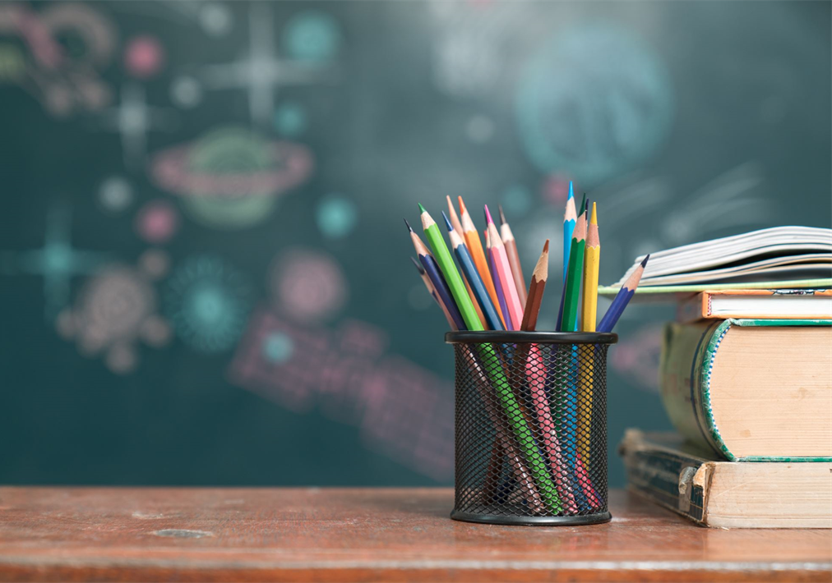
Meet the Teacher
September
2025
Welcome to Year 4

Slide 2
Teachers
Welcome to 4H
Teacher: Mrs Holder

Slide 3
Times
Start of the school day – 8.50am
Door - Around new hall on ks2 yard- Year 3 and year 6 entrance.
Morning Challenge- start as soon as they come into class.
End of the school day – 3.30pm
Children will be brought onto the ks2 yard, lined up and dismissed one at a time.
If your child is being collected by anyone different eg a friend’s mum, please inform the school office.
Morning –doors open 8.45am
Lunch – 12.20-1.20pm

Slide 4
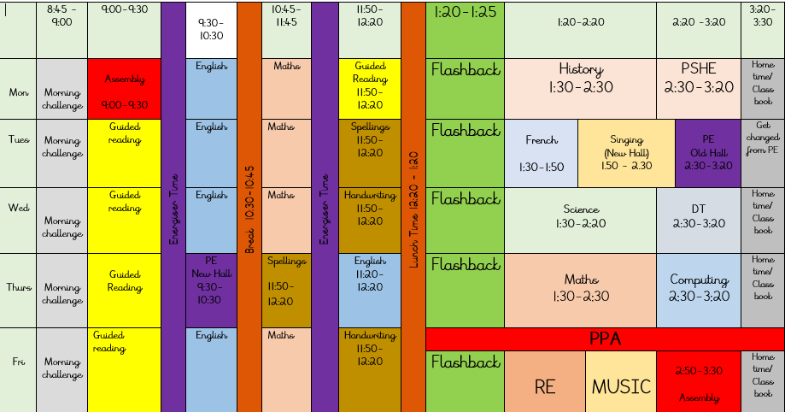
Example Timetable

Slide 5
Playtime
Fruit will be available everyday
Fruit, vegetables, cheese or yoghurt are the only snack for breaktime that may be brought from home.
Times
10.30 – 10.45

Slide 6

Homework
Out: Friday Due in; Wednesday ​
Home work not completed will be done in break or lunchtimes.
Homework handed in by Wednesday please!
Alternate Math and English homework (completed in their homework books t consolidate learning).
Children to read minimum 3 times per week and have their reading record signed. by an adult.
TTR info shared via Dojo. Important for Statutory times table test.
Spellings – taught in school and practice at home. (statutory words on next slide)
Homework Club – Thursday

Slide 7
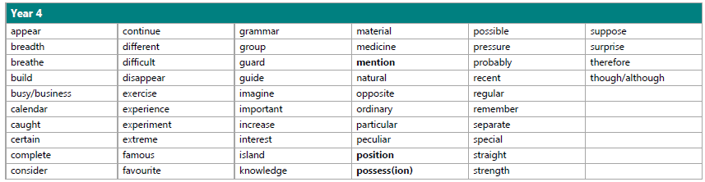
Year 4 spellings

Slide 8
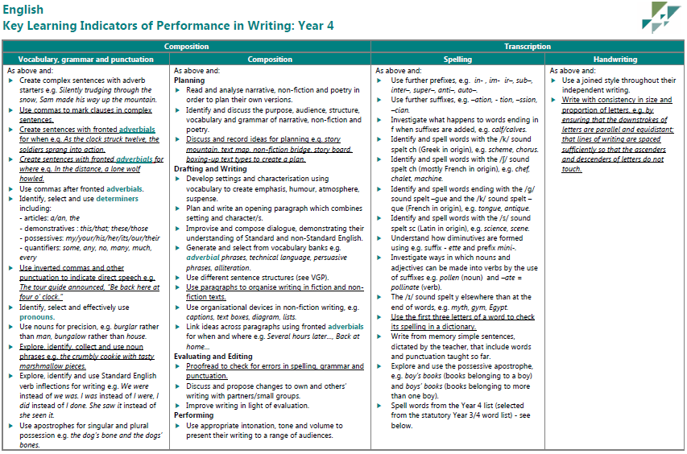
What is expected for a child in year 4?

Slide 9
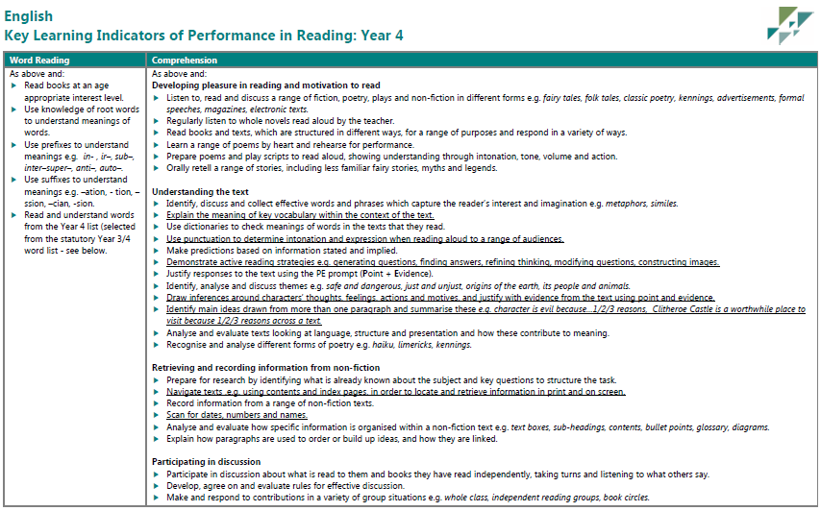

Slide 10
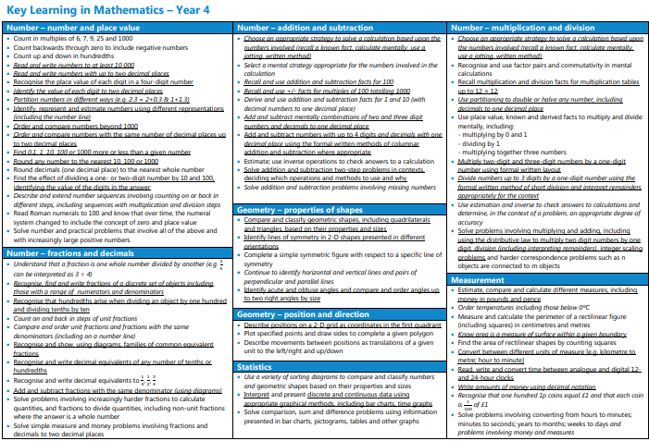

Slide 11

National Assessments
Multiplication tables check.
Statutory
Fluent recall of times tables.
Dates – June 2026

Slide 12
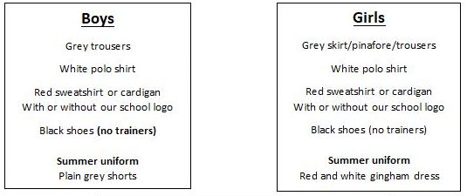
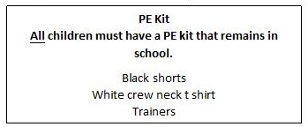
School uniform
If earrings are worn, they must be small plain studs and for health and safety reasons must not be worn for PE.
Please make sure all uniform is clearly named.
No watches or jewellery.
No rucksacks or pencil cases.

Slide 13

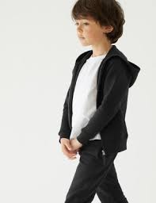
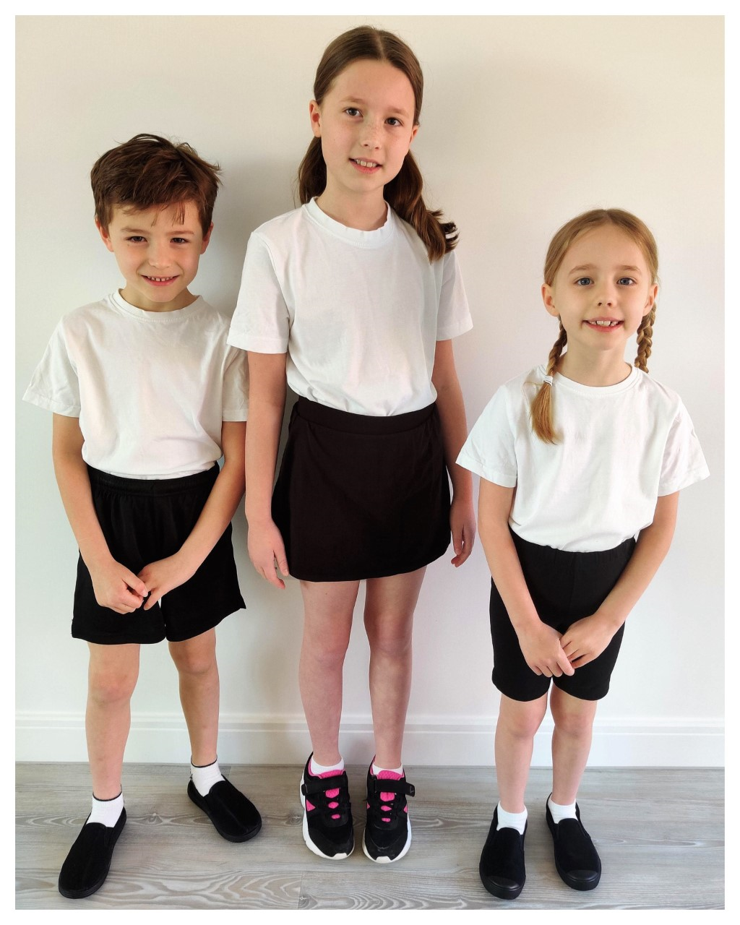

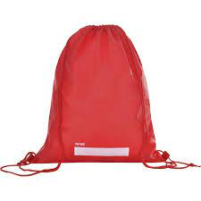
P.E.
P.E. Will be twice a week. The days will be shared on the class newsletter in September. Please ensure your child has a full PE kit in school at all times. black/navy shorts or joggers and a white T-shirt, black pumps or trainers.
Earrings are not allowed during PE for safety reasons.
Please label everything!

Slide 14

Water Bottles
Please bring in a filled water bottle with your child’s name on. The children will be able to drink water throughout the day. Water only please!

Slide 15


Updates
Reminders
Links to learning on class page- Website
Unfortunately, we can’t use it as a messaging service. Please speak to or email the school office if you need to contact us directly.
ScoPay
Ordering dinner
Consent
Website
Calendar
Class newsletter
Parents evening
Telephone
Weekly newsletter

Slide 16
Independence
It is really important that you children continues to develop their independence this year.
Organisation of equipment and classroom.
Looking after belongings.
Shoelaces.
Earrings
Packing bags at the end of the day.
Within learning.
Reading books

Slide 17
Medication
If your child needs any prescribed medication please complete a medicine form.
We will administer non prescribed medicine eg antihistamine but this must be a brand new sealed bottle accompanied by a medicine form.
All medicine to be taken to the school office.

Slide 18

Parents Evening
October or November
You will be asked to book your appointment on Scopay nearer the time.

Slide 19
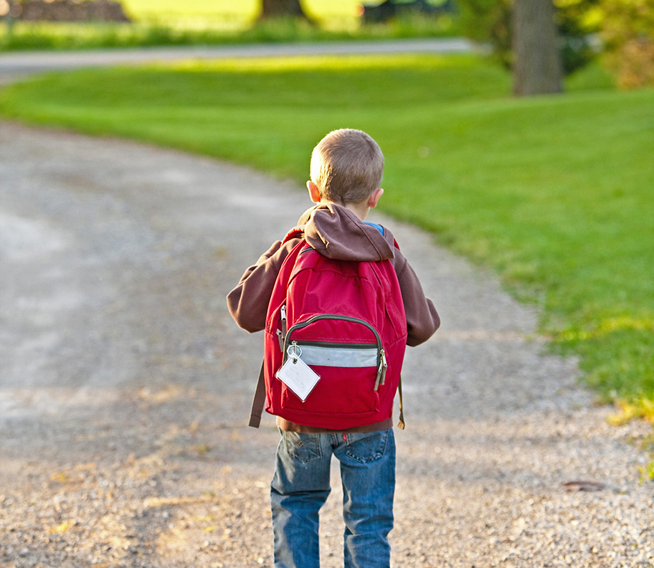
Thank You!

