Slide 1

Meet the Teacher
10th July
2025
Welcome to Year 5

Slide 2
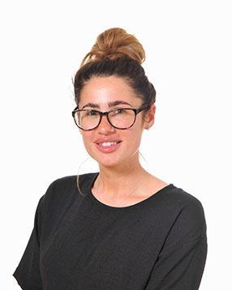
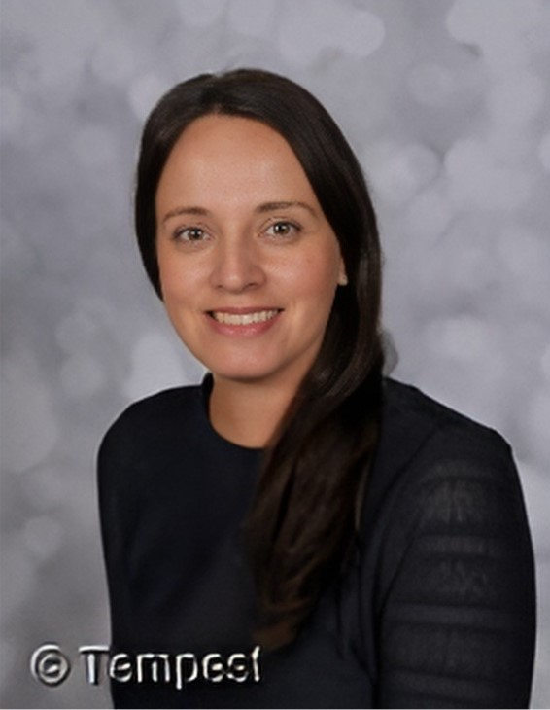
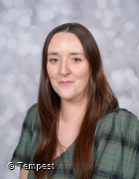
Teachers and TA
Miss Lonsdale, Miss Burnett and Mrs Wimbles.
PPA cover once a week.

Slide 3
Times
Start of the school day – 8.55am
Upper KS2 Door
Morning Challenge
End of the school day – 3.30pm
Door / arrangements
If your child is being collected by anyone different eg a friend’s mum, please inform school.
Year 5 and 6 - Walking Home? Written permission!
Morning –doors open 8.45am
Lunch – 12.20pm

Slide 4
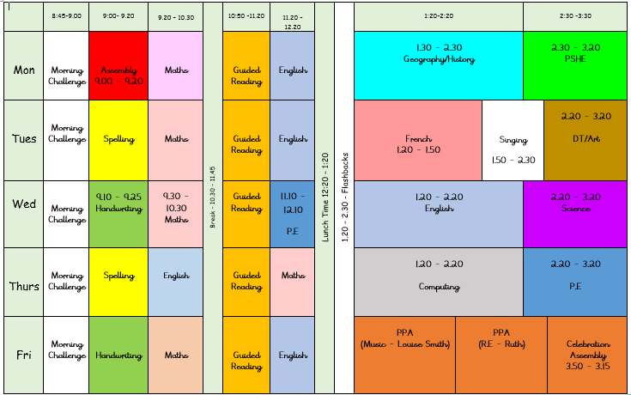
Example Timetable

Slide 5
Playtime
Fruit available everyday
Fruit, vegetables, cheese or yoghurt from home
Times
Morning – 11am
15 minutes

Slide 6

Homework
Out: Friday Due in: Wednesday ​
Homework handed in by Wednesday please!
Alternate Maths and English homework
Children to read minimum 3 times per week and have their reading record signed.​ Checked Wednesday to Wednesday
Homework info shared via Dojo
Homework Club – Thursday

Slide 7


Reading
Reading at least 3 times a week!
Books are checked every morning and changed when needed..... Please sign your child’s reading record each time they have read . They need to bring their books in their reading bags everyday please.

Slide 8
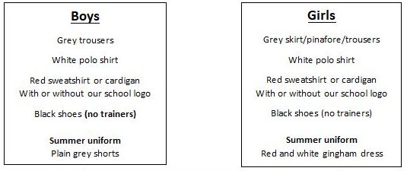
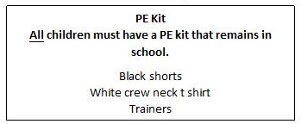
School uniform
If earrings are worn, they must be small plain studs and for health and safety reasons must not be worn for PE
Please make sure all uniform is clearly named
No watches or jewellery
No rucksacks or pencil cases

Slide 9

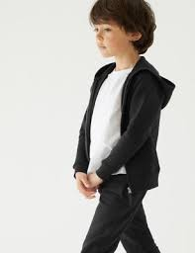
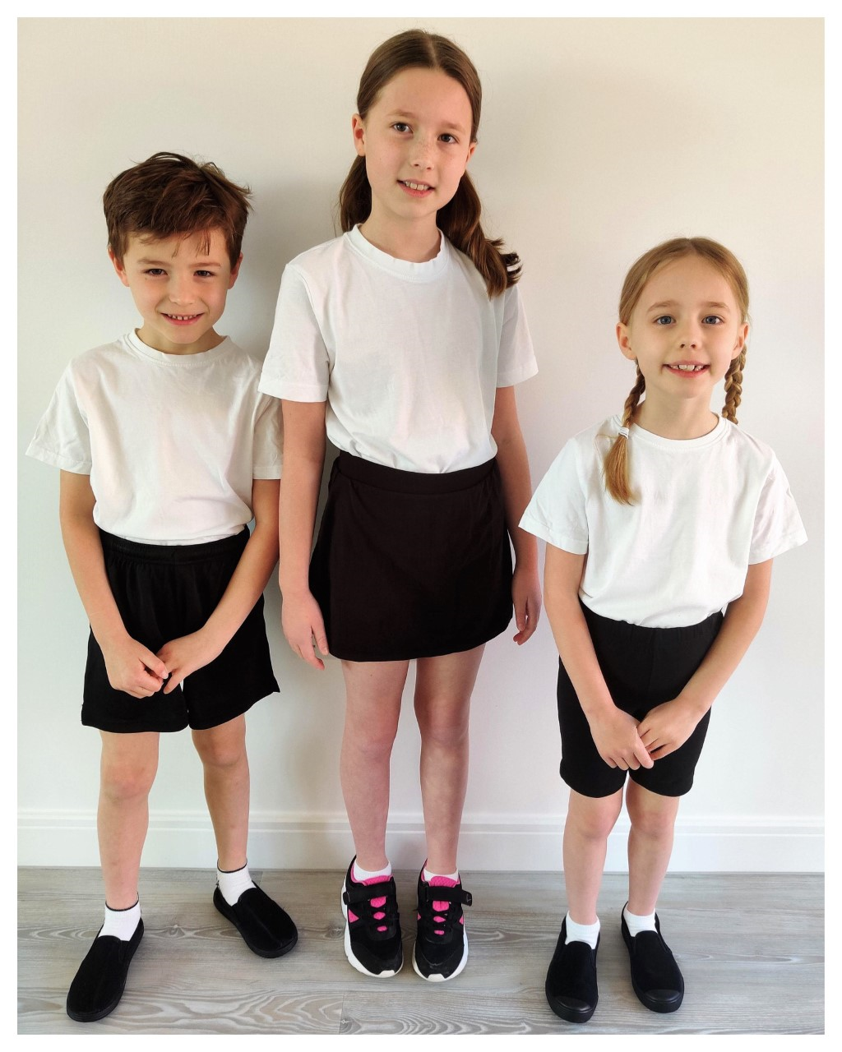

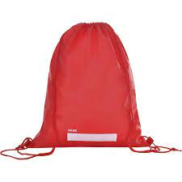
P.E.
P.E. Will be twice a week. The days will be shared on the class newsletter in September. Please ensure your child has a full PE kit in school at all times. black/navy shorts or joggers and a white T-shirt, black pumps or trainers.
Please label everything!

Slide 10

Water Bottles
Please bring in a filled water bottle with your child’s name on. The children will be able to drink water throughout the day. Water only please!

Slide 11


Updates
Reminders
Links to learning on class page- Website
Unfortunately, we can’t use it as a messaging service. Please speak to or email the school office if you need to contact us directly.

Slide 12
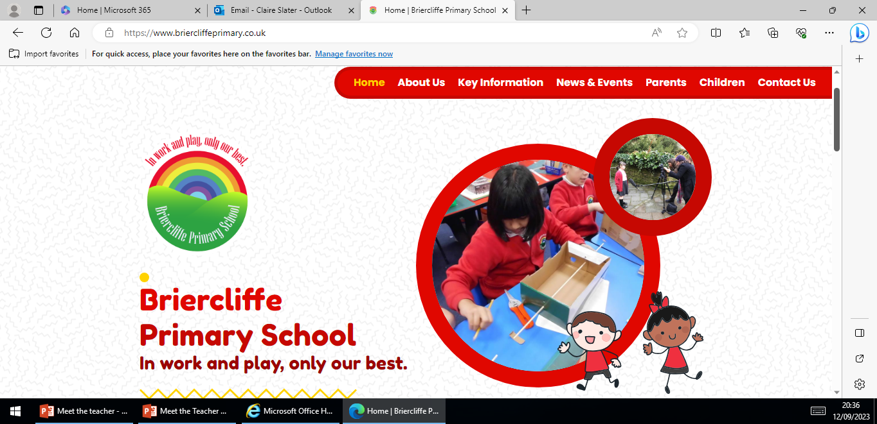
Website
Website Home | Briercliffe Primary School
Calendar
Class newsletter
Weekly Photos on class page

Slide 13
Independence
Organisation
Looking after belongings
Shoelaces
Packing bags at the end of the day
Within learning
Reading books

Slide 14
Medication
If your child needs any prescribed medication please complete a medicine form.
We will administer non prescribed medicine eg antihistamine but this must be a brand new sealed bottle accompanied by a medicine form.
All medicine to be taken to the school office.

Slide 15

Parents Evening
October or November

Slide 16
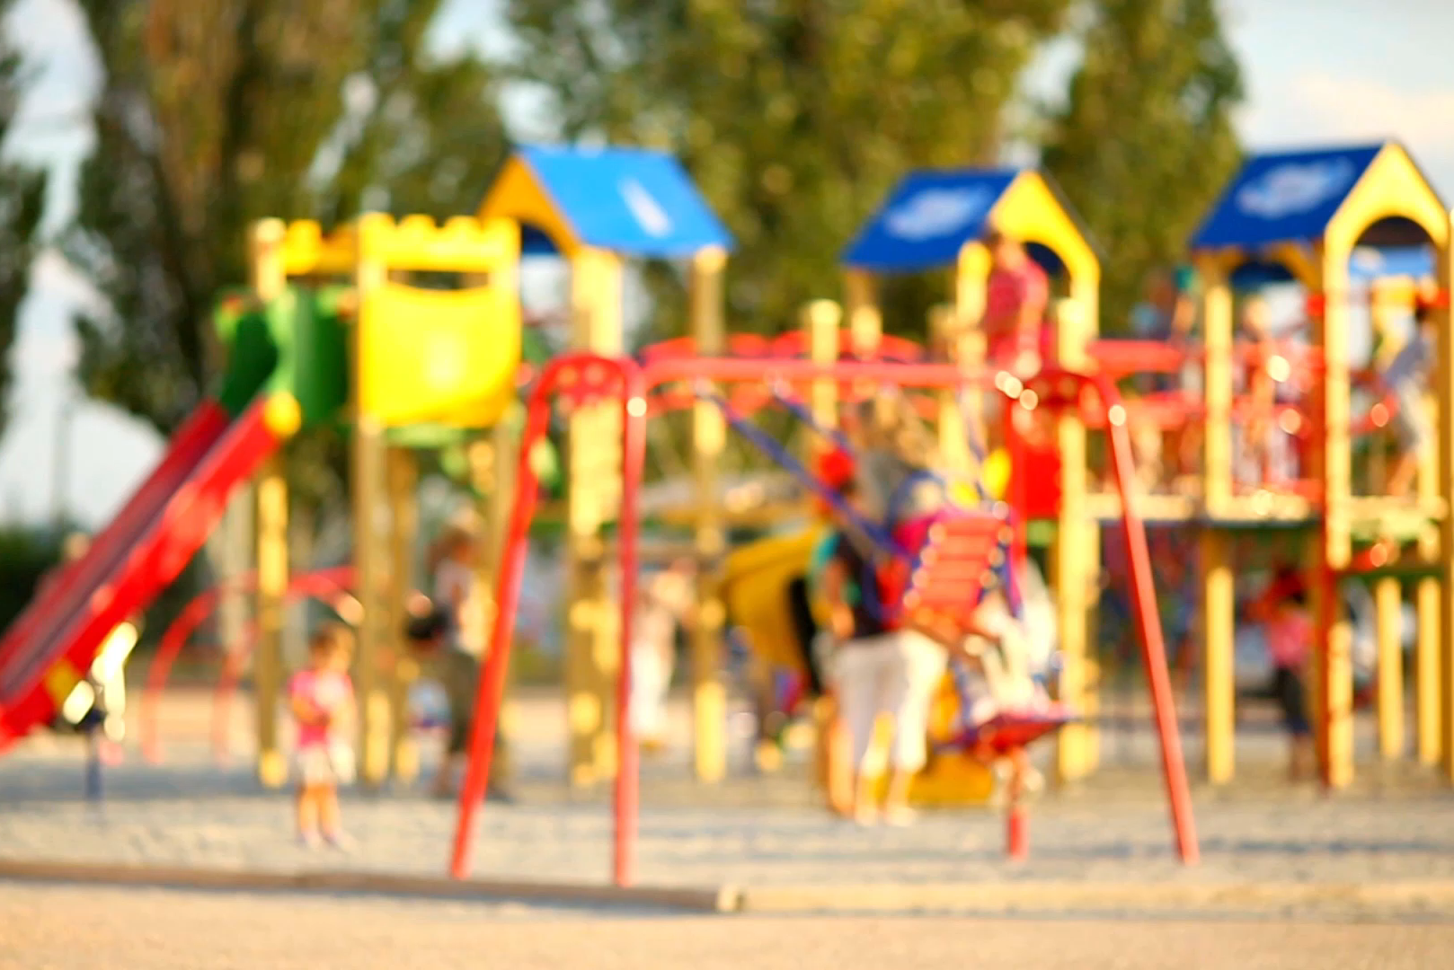
Please Remember…
Send your child in with:
PE kit
Water bottle
Coat
Book bag
Labelling!
After school and before school please can children not play on climbing frames/trim trails.

Slide 17
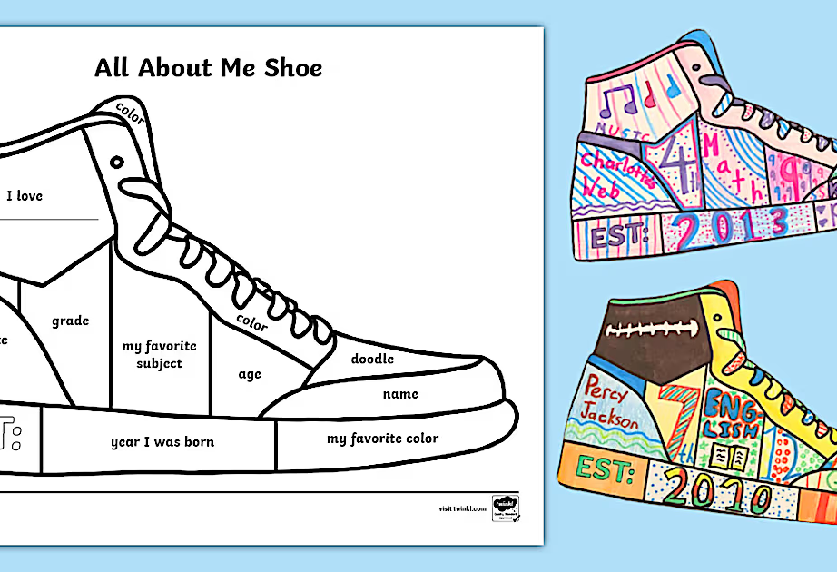
Any questions?

Slide 18
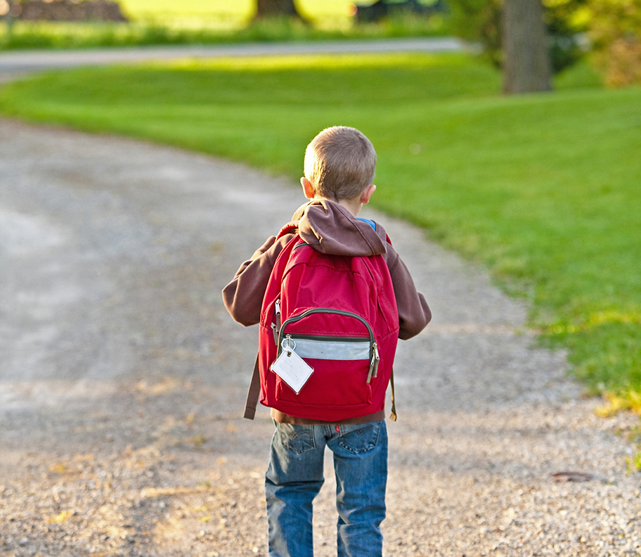
Thank You!

